Slide 1
The Imaging X-ray Polarimetry Explorer
Martin C. Weisskopf
NASA Marshall Space Flight Center
Presentation to Caltech
November 4, 2020

Slide 2
Brief Outline
Polarimetry in the classical X-ray band (2-10 keV)
  Sounding rocket experiments
  OSO-8 crystal polarimeter
  The Stellar X-ray Polarimeter on Spectrum-X
IXPE
  How it works
  The science

Slide 3
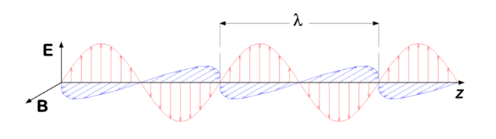
Polarization
Polarization is a property of electro-magnetic waves connected with the direction of the electric and magnetic fields which are themselves transverse to the direction of propagation.
It is the direction of the electric vector that determines the direction of the polarization
The degree of polarization and the “position angle on the sky” depend on the conditions under which the X-rays are produced
Thus modeling of what we see must also predict the degree of polarization and the position angle

Slide 4
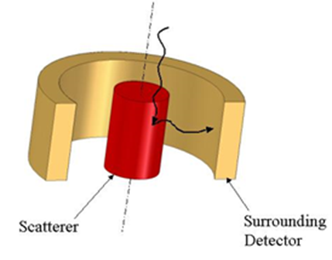
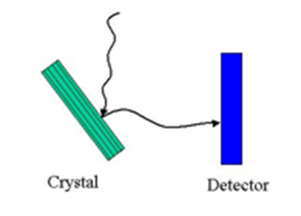
How does one measure X-ray Polarization?
First devices were scattering polarimeters
  The scattering material should be thick (deep) in order to effectively provide for interaction with all the incident photons.
  The scattering material should be thin (narrow) in order to allow the scattered photon to easily escape.
Bragg crystal polarimeters
  Narrow band
  Low efficiency

Slide 5
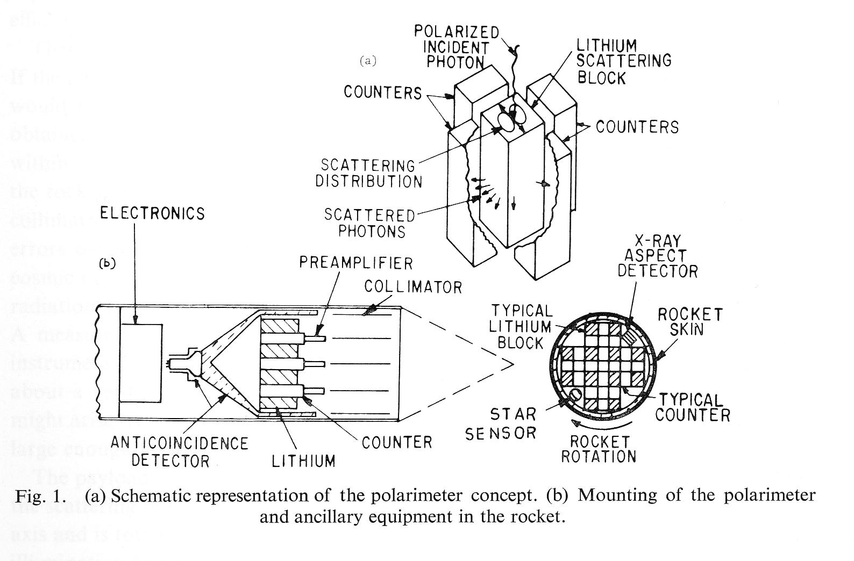
In the beginning
July 1968 – Lithium-block, “Thomson”- scattering polarimeter flown on an Aerobee 150 sounding rocket
  Target was the brightest X-ray source Sco X-1
Notes:
Inherently broad band device
Astrophysical non-thermal spectra are characteristically broad band
Astrophysical diagnostics (model discriminators) may/should benefit from understanding the energy dependence

Slide 6
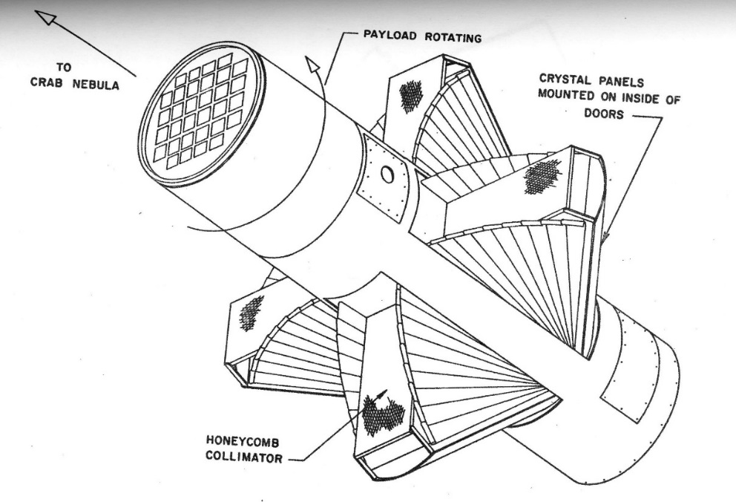
Rocket 17.09 (Aerobee 350) 1971

Slide 7
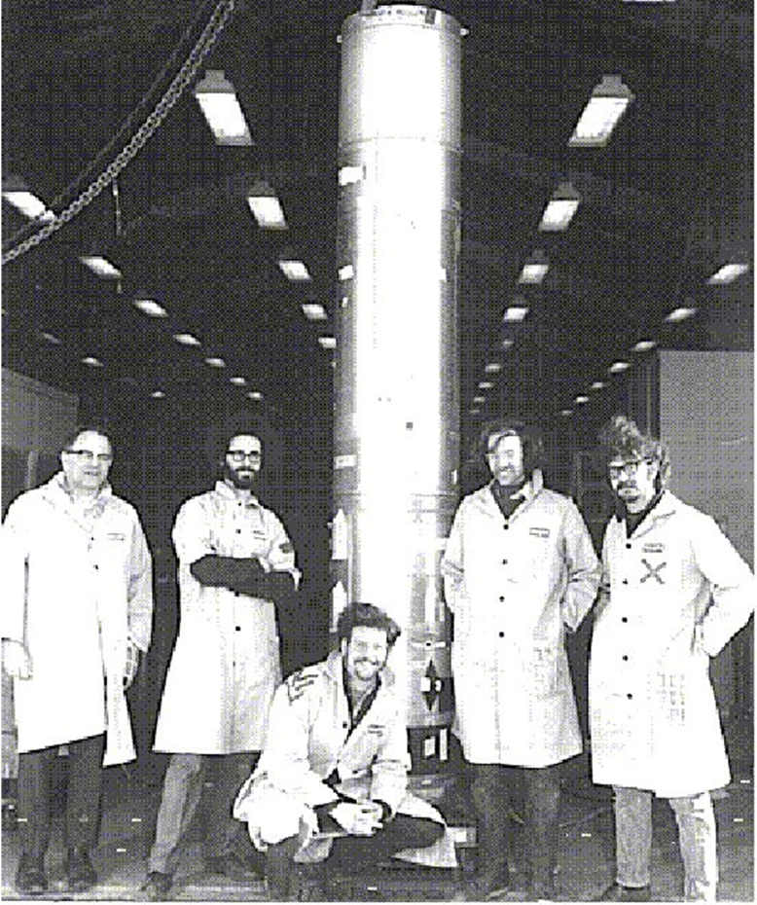
Rocket 17.09
Crab detection!
  P = 15% ± 5%
  φ = 156° ± 10°
Yes, I am the handsome one

Slide 8
The Stellar X-ray Polarimeter (SXRP)
Planned to fly on the Russian Spectrum-X Gamma Mission in the early 1990s --- but was never launched

Slide 9
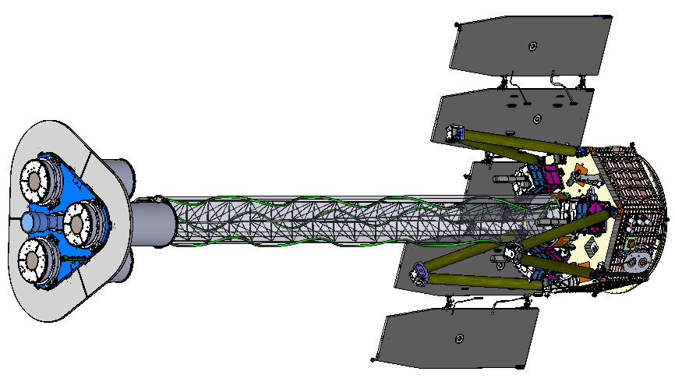
IXPE Deployed
MMA
(1 of 3)
DU
(1 of 3)
Forward Star Tracker
5.2 m total length
4.0 m focal length

Slide 10
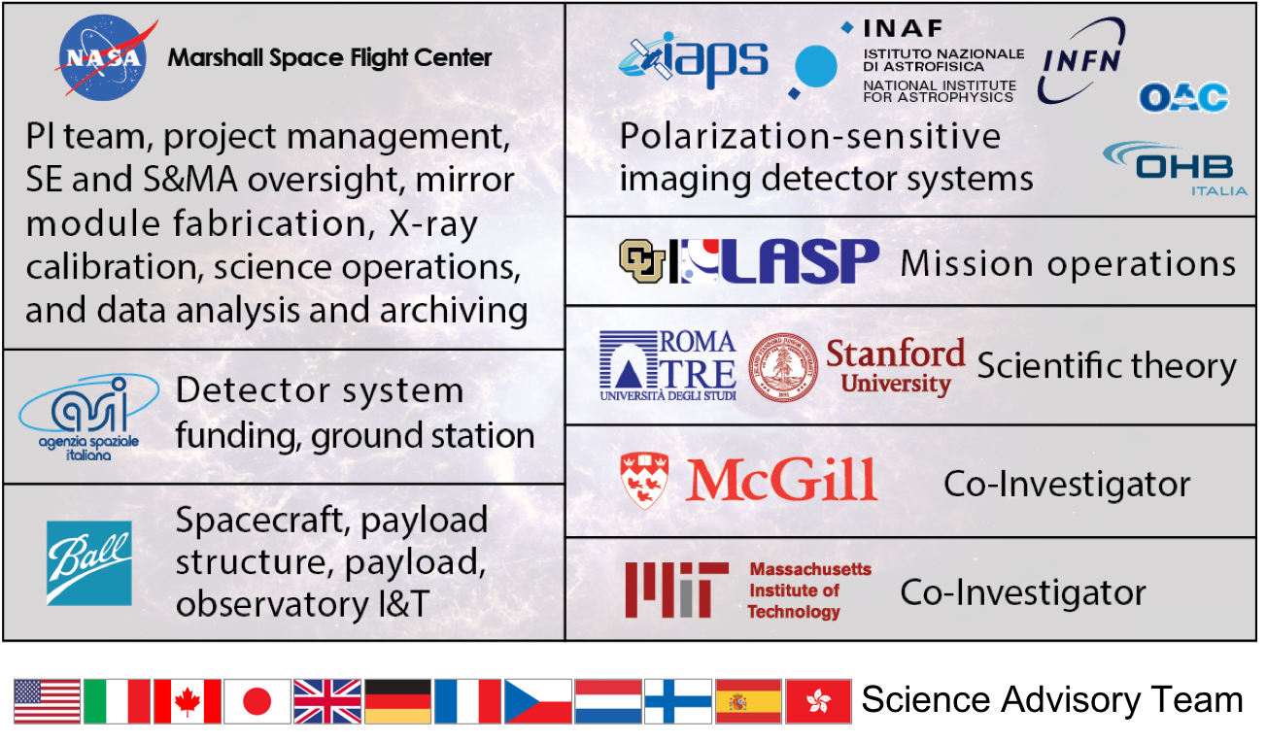
The IXPE Team
SAT currently comprises > 90 scientists from 12 countries

Slide 11
Mission Description
Launch Fall 2021 on a Falcon 9 from KSC
600-km circular orbit at a nominal 0° inclination
2-year baseline mission, optional extension with GO program
Point and stare (with dither) at pre-selected targets
Malindi ground station - primary (Singapore - secondary)
Mission Operations Center (MOC) at the University of Colorado, Laboratory for Atmospheric and Space Physics (LASP)
Sciences Operations Center (SOC) at MSFC
Data archiving at NASA’s HEASARC
  During the first 3 months of the mission, including one month of orbital checkout, all IXPE data shall be made publicly available at the HEASARC within 30 days of the end of an observation, which is defined as when data for 90% of the scheduled observation time are received by the MOC.
  After the first 3 months of the mission, data shall be made available to the HEASARC within 1 week of the end of an observation, which is defined as when data for 90% of the scheduled observation time are received by the MOC.

Slide 12
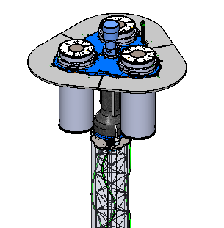
Shield and Collimator Suppress Background
Off-axis background
Shield
Detector unit
On-axis Target
X-ray
Shield
Mirror Module Assembly

Slide 13
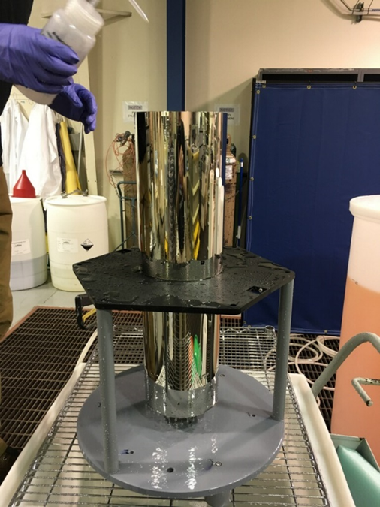
Mirror Production Process
Mandrel fabrication
1. Machine mandrel from aluminum bar
2. Coat mandrel with electroless nickel (Ni-P)
3. Diamond turn mandrel to sub-micron figure accuracy
4. Polish mandrel to 0.3-0.4 nm RMS
5. Conduct metrology on the mandrel
Mirror-shell forming
6. Passivate mandrel surface to reduce shell adhesion
7. Electroform Nickel/Cobalt shell onto mandrel
8. Separate shell from mandrel in chilled water
Ni/Co electroformed IXPE mirror shell
(+)
(-)
(+)

Slide 14
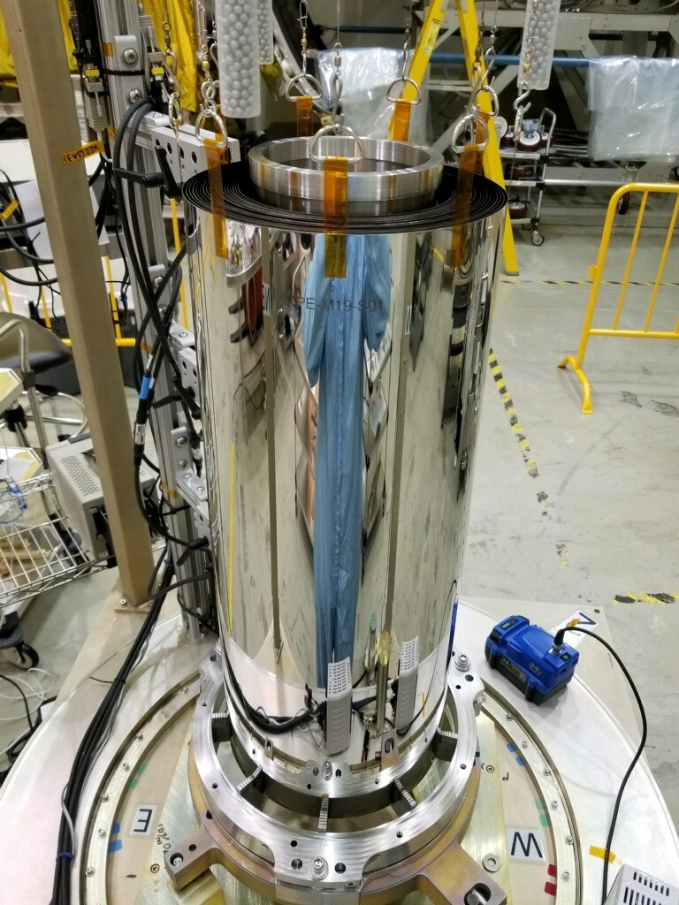
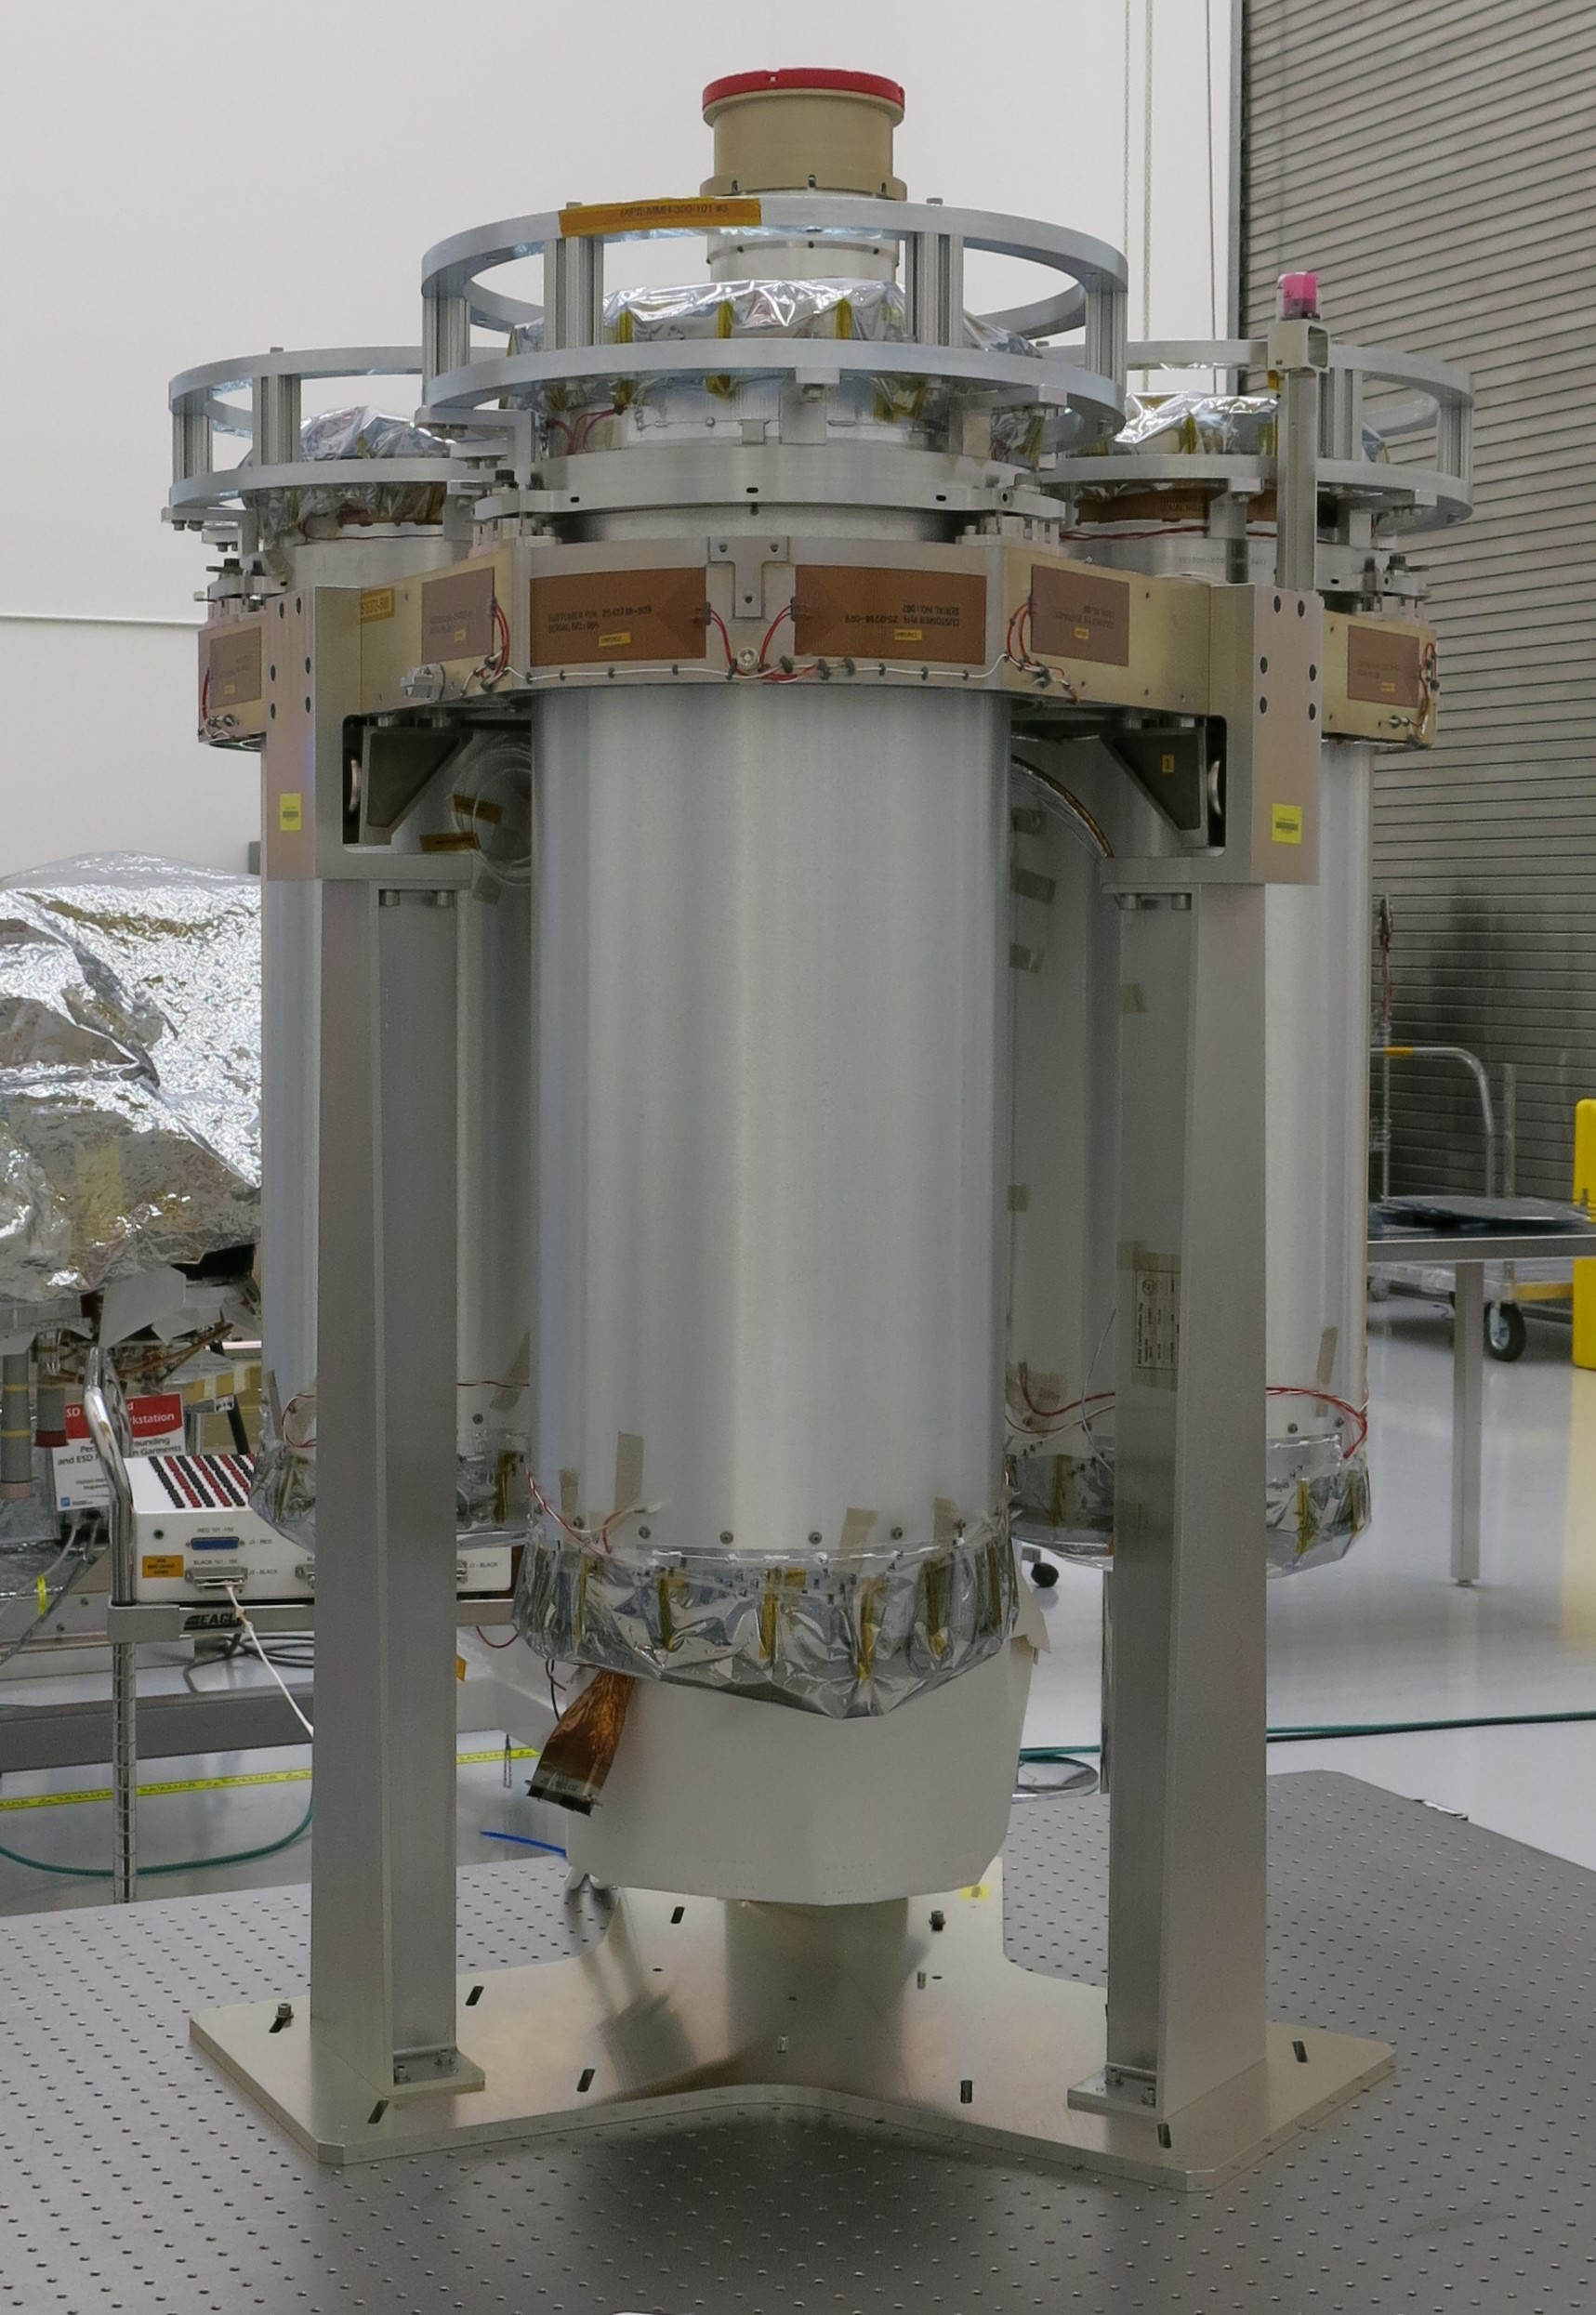
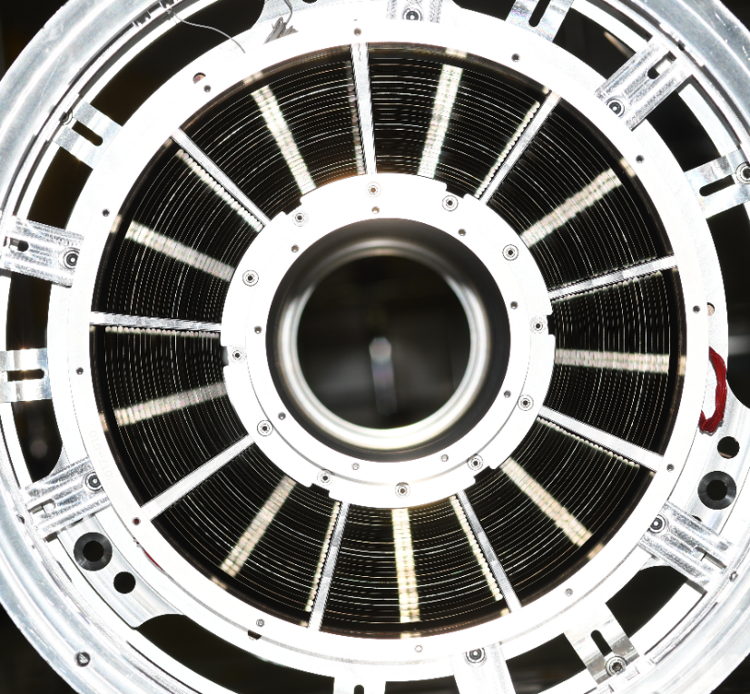
The Optics

Slide 15
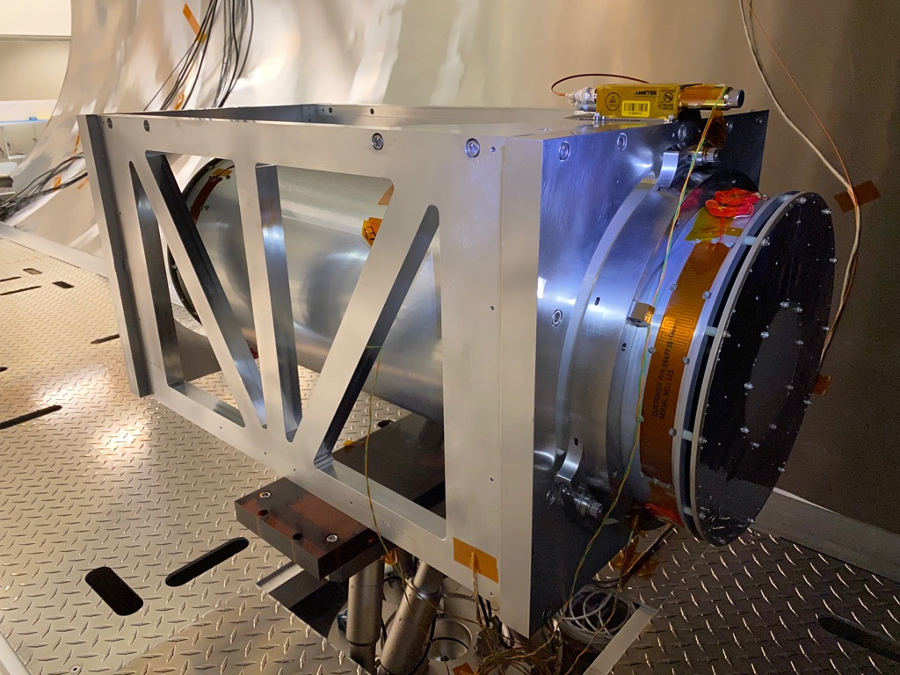
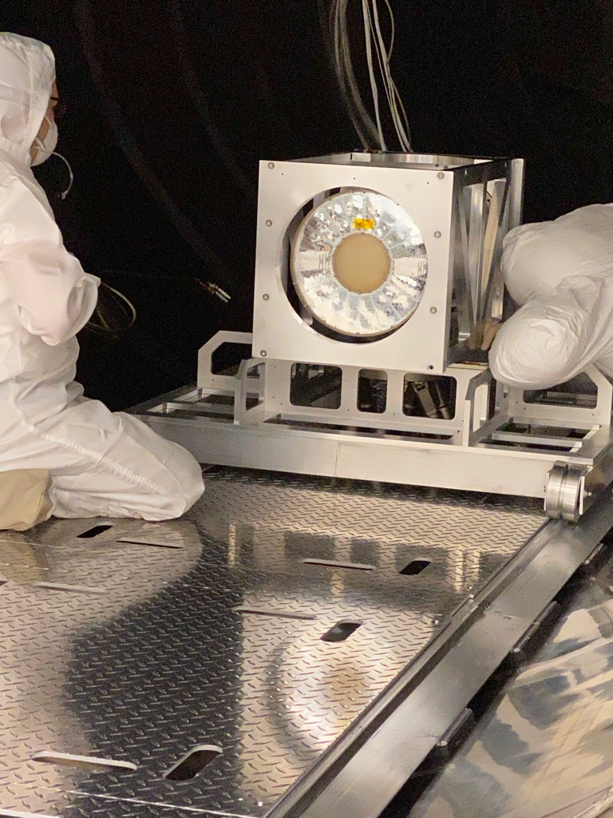
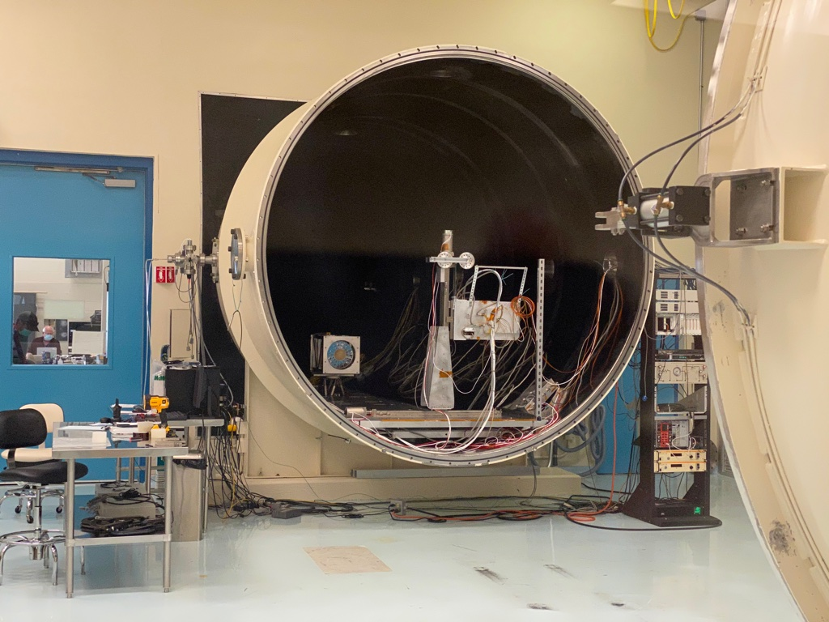
Stray Light Test Facility
X-ray calibration of the MMAs at MSFC’s 100-m X-ray test facility

Slide 16
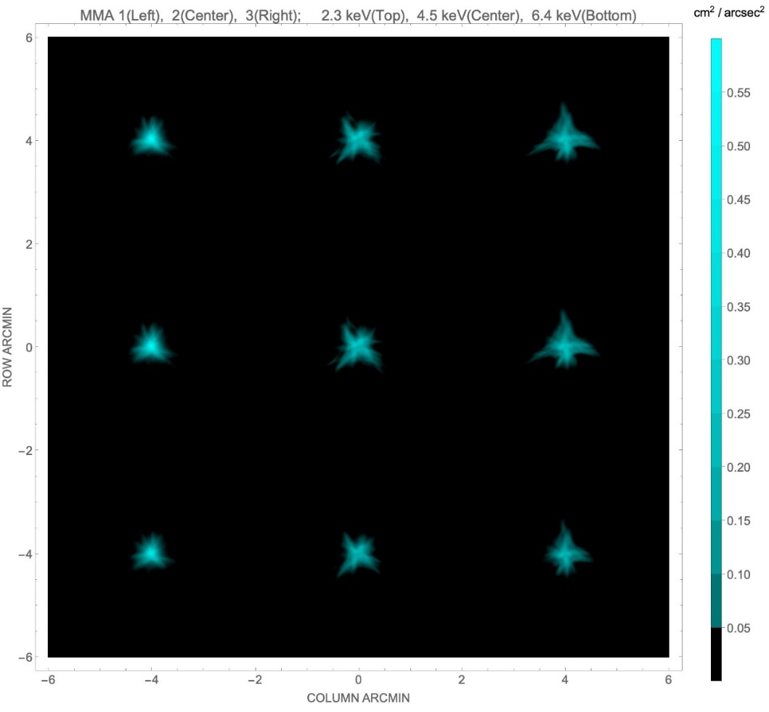
Angular Resolution
MMA | #1 | #2 | #3
6.4 keV | 18.9″ | 24.8″ | 24.2″
4.5 keV | 18.9″ | 25.0″ | 26.9″
2.3 keV | 18.7″ | 24.5″ | 26.7″
Values in the table are half-power diameters (HPDs) for the individual MMAs alone. These need to be adjusted for alignment errors, detector resolution, focus etc. to determine the on-orbit system-level resolution.
Based upon X-ray calibration and analysis, the system-level performance is 28″ HPD

Slide 17
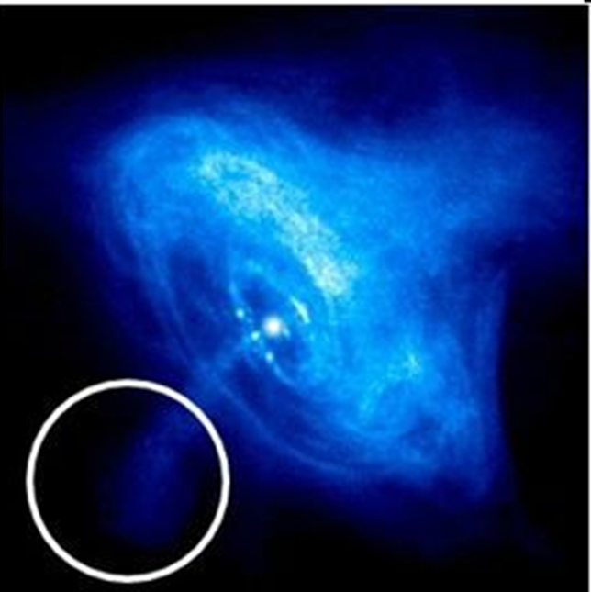
Imaging polarimetry
IXPE 30″ half-power diameter on Chandra image

Slide 18
Mirror Module Assembly Properties
Property | Value
Number of modules | 3
Mirror shells per module | 24
Inner, outer shell diameter | 162, 272 mm
Total shell length | 600 mm
Inner, outer shell thickness | 180, 250 µm
Shell material | Nickel cobalt alloy
Effective area per module | 163 cm² (2.3 keV) ~ 192 cm² (3-6 keV)
Angular resolution | ≤ 27 arcsec HPD
Detector limited FOV | 12.9 arcmin
Focal length | 4 m
Mass (3 assemblies) | 95 kg with contingency

Slide 19
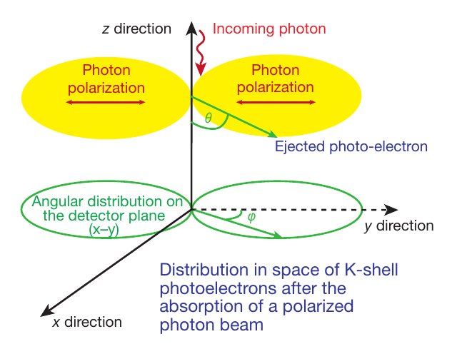
Detection Principle
The detection principle is based on the photoelectric effect

Slide 20
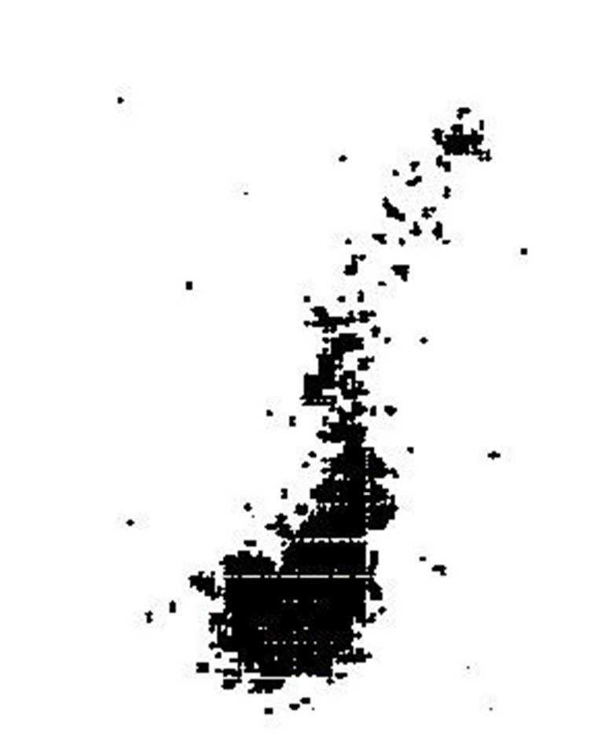

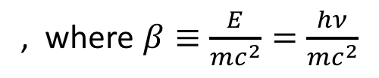
The Polarization-Sensitive Detectors
The initial direction of the K-shell photoelectron is determined by the orientation of the incident photon’s electric vector
Initial direction of photoelectron
Site of initial ionization and Auger electron cloud
The distribution of the photoelectron initial directions determines the degree of polarization and the position angle
, where $β≡\frac{E}{mc^{2}}=\frac{hν}{mc^{2}}$

Slide 21
Detector Properties
Parameter | Value
Sensitive area | 15 mm × 15 mm (13 x 13 arcmin)
Fill gas and composition | DME @ 0.8 atmosphere
Detector window | 50-µm thick beryllium
Absorption and drift region depth | 10 mm
GEM (gas electron multiplier) | copper-plated 50-µm liquid-crystal polymer
GEM hole pitch | 50 µm triangular lattice
Number ASIC readout pixels | 300 × 352
ASIC pixelated anode | Hexagonal @ 50-µm pitch
Spatial resolution (FWHM) | ≤ 123 µm (6.4 arcsec) @ 2 keV
Energy resolution (FWHM) | 0.57 keV @ 2 keV (∝ √E)
Useful energy range | 2 - 8 keV

Slide 22
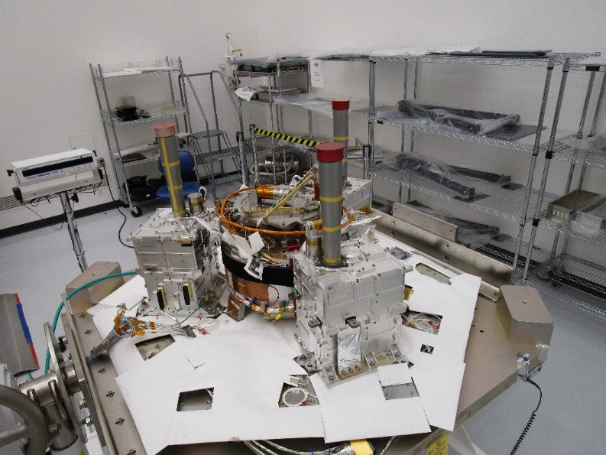
The Detectors
The Detector Units (DUs) mounted to the spacecraft top deck at Ball

Slide 23
Filter Calibration Wheel Assembly
Filter and Calibration Wheel (FCW), providing open, attenuator, and closed positions, plus four ⁵⁵Fe-powered calibration sources:
  Cal A – Bragg-reflected polarized 2.98-keV (Ag-L𝛼 fluorescence) and 5.89-keV (Mn-K𝛼)
  Cal B – unpolarized 5.89-keV spot
  Cal C – unpolarized 5.89-keV flood
  Cal D – unpolarized 1.74-keV (Si-K𝛼 fluorescence) flood

Slide 24
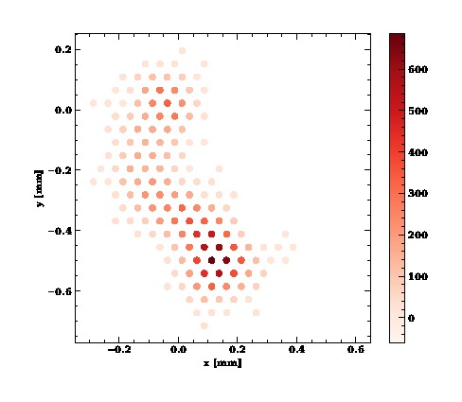

Analysis Based upon Neural Networks
Baseline moments analysis is a simple, effective, long-studied and well-understood method of extracting information from ionization tracks made by a photo-electron in the detector gas
Machine Learning (neural-network) techniques can extract more information from each track
  Improves position-angle (PA) measurements, especially at high energy
  Computes statistical and reconstruction errors for each event
  Mildly improves estimates of the energy and conversion point of each event

Slide 25
The Minimum Detectable Polarization (MDP)
R_{S} is the observed source counting rate
R_{B} is the observed background counting rate
t is the integration time
M is the modulation factor, i.e. the amplitude of the variation of the ensemble of position angles for a 100% polarized source
The power of the neural-network analysis for an ensemble of events in the case of IXPE, is as if we were flying 4 rather than 3 optics/detector combinations!

Slide 26
Radio Pulsars
Radio Pulsars
  Perform X-ray phase-resolved polarimetry to test models for a radio pulsar’s X-ray emission
  Grey is optical, blue is IXPE
Emission geometry and processes are still unsettled.
Competing models predict differing polarization behavior with pulse phase.
X-rays provide clean probe of geometry.
Absorption likely more prevalent in visible band.
Radiation process entirely different in radio band.
  Recently discovered no pulse phase-dependent variation in polarization degree and position angle @ 1.4 GHz.
140-ks observation gives ample statistics to track polarization degree and position angle.

Slide 27
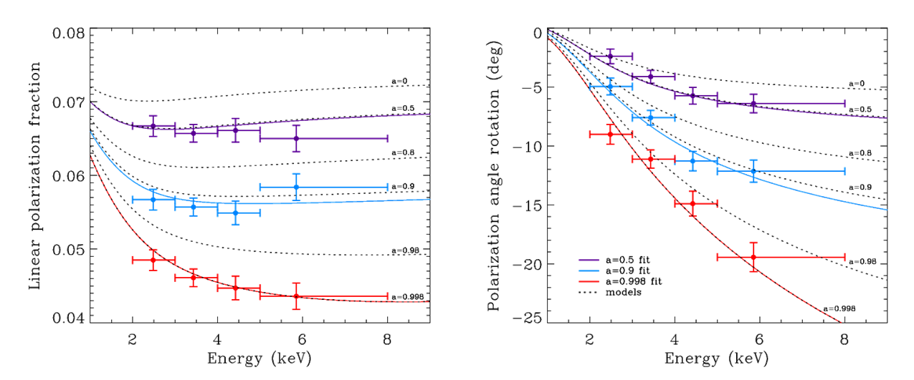
Microquasars
Microquasars
  Perform X-ray spectral polarimetry on microquasars to use the position angle to help localize the emission site (accretion disk, corona, jet)
  For a micro-quasar in an accretion-dominated state, scattering polarizes the disk emission.
  Polarization rotation versus energy is greatest for emission from inner disk.
    Inner disk is hotter, producing higher energy X-rays.
  Disk orientation from other experiments used to constrain GRX1915+105 model.
    a = 0.50±0.04; 0.900±0.008; 0.99800±0.00003 (200-ks observation)

Slide 28
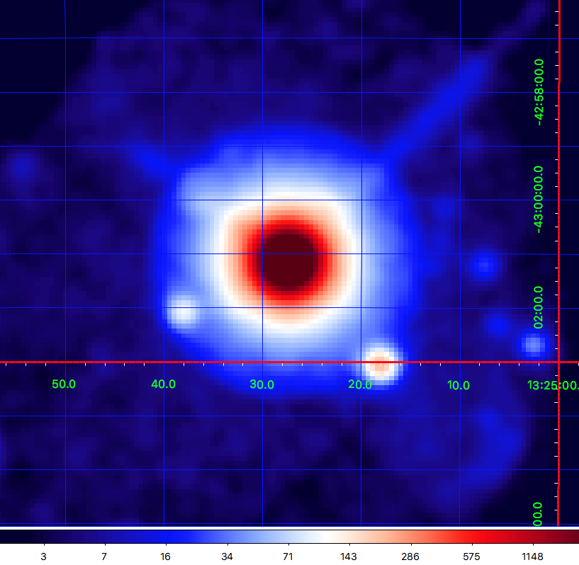
Active Galaxies: CEN A
Active galaxies are powered by supermassive BHs with jets
  Radio polarization implies the magnetic field is aligned with jet
  Different electron-acceleration models predict different dependence in X-rays
Region | MDP₉₉
Core | 1.4%
Knots C+F+G | 21%
ULXs | 25% 15%
ULX sources

Slide 29
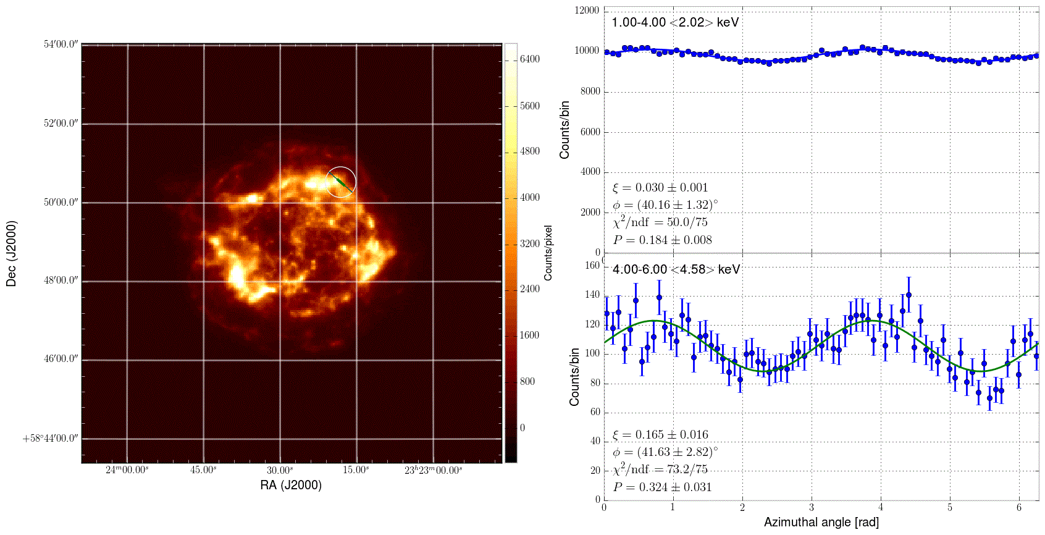
Supernova Remnants
Supernova Remnants (SNR – e.g. CAS-A)
  Use X-ray polarmimetric imaging to examine the magnetic-field topology in the X-ray emitting regions of (shell-type) SNR, which are candidate sites for cosmic-ray acceleration (Entire image measured simultaneously)
Lines and thermal continuum dominate 1-4 keV.
Non-thermal emission dominates 4-6 keV.

Slide 30
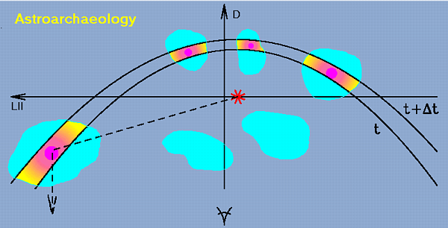
Was SGR A* recently 10⁶ × more active?
Galactic Center molecular clouds (MC) are known X-ray sources
  If the MCs reflect X-rays from Sgr A*, the X-radiation would be highly polarized perpendicular to plane of reflection and indicate the direction back to Sgr A*
    If true, Sgr A* X-ray luminosity was 10⁶ larger ≈ 300 years ago
    If not, still a discovery

Slide 31
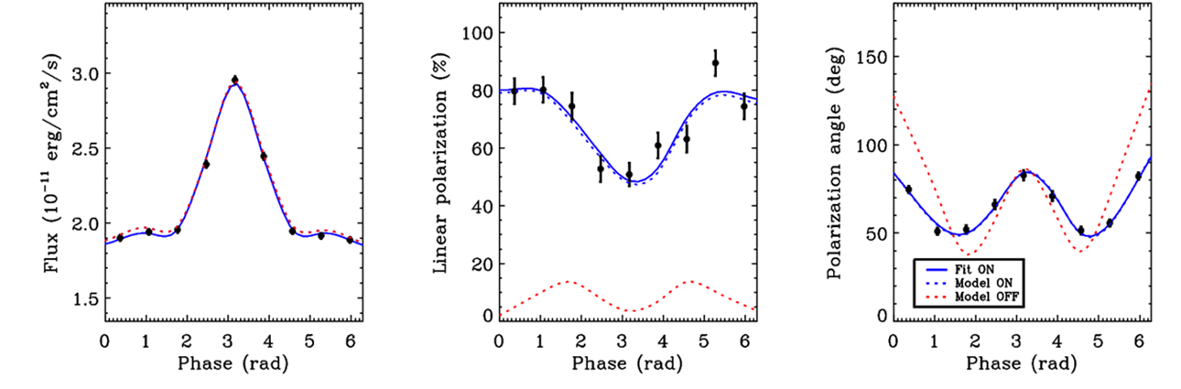
Test QED
Study magnetars (pulsing neutron stars with magnetic fields up to 10¹⁵ Gauss)
  Non-linear QED predicts magnetized-vacuum birefringence
    Refractive indices of the two polarization modes differ from 1 and from each other
    Impacts polarization and position angle as functions of pulse phase, but not the flux
    Example is 1RXS J170849.0-400910, with an 11-s pulse period
    Can exclude QED-off at better than 99.9% confidence in 250-ks observation

