Slide 1



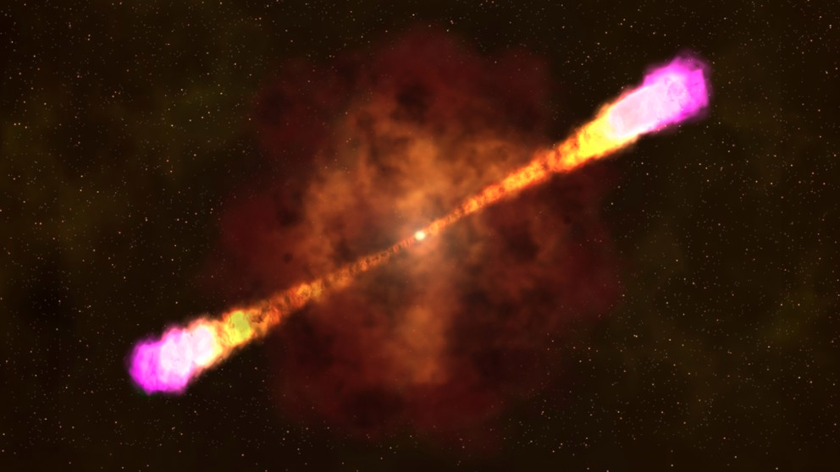
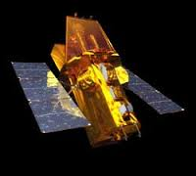
Swift Burst Alert Telescope
Amy Lien
Goddard Space Flight Center
Caltech X-ray Club, 2020/10/13

Slide 2
Outline
Exploring the Universe with BAT
BAT instrument
  BAT detectors
  Coded aperture method
BAT data product
  BAT GRB catalog
  BAT transient monitor
  BAT survey catalog
Finding weak sources in BAT

Slide 3
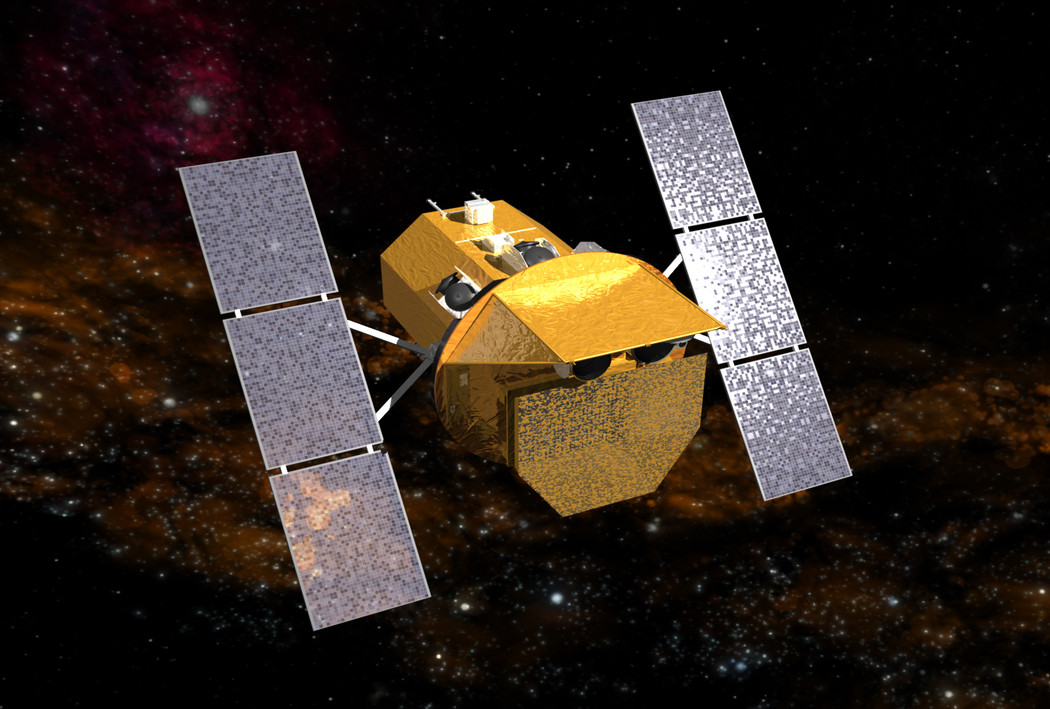
BAT science Coded mask BAT products Weak sources Summary
Neil Gehrels Swift Observatory
UV/Optical Telescope (UVOT)
X-Ray Telescope (XRT)
Burst Alert Telescope (BAT)
Gehrels et al. (2004)

Slide 4
BAT science Coded mask BAT products Weak sources Summary
Neil Gehrels Swift Observatory
Launched in Nov. 20, 2004
Dedicated for GRB study
Extend beyond GRB science and has become an observatory that serves a much wider community
UV/Optical Telescope (UVOT)
X-Ray Telescope (XRT)
Burst Alert Telescope (BAT)
Gehrels et al. (2004)

Slide 5
BAT science Coded mask BAT products Weak sources Summary
Neil Gehrels Swift Observatory
Burst Alert Telescope (BAT)
Gehrels et al. (2004)

Slide 6
Burst Alert Telescope (BAT)
BAT science Coded mask BAT products Weak sources Summary
Responsible for finding GRBs
15-350 keV
Large field of view (~ 1/6 of the sky) → Increase the number of GRB detections
  ~1.4 sr (half coded)
  ~ 2 sr (fully coded)
Decent localization in hard X rays (~ 3 arcmin) → Enable prompt follow-up of narrow field instruments

Slide 7

Swift GRBs to date: 15.9 Years after Launch
BAT science Coded mask BAT products Weak sources Summary
1326 GRBs (～ two per week)
459 GRBs with distance measurements
Swift/BAT GRB catalog:
https://swift.gsfc.nasa.gov/results/batgrbcat/

Slide 8
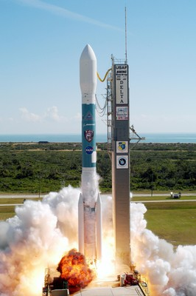
15.9 Years of Swift
BAT science Coded mask BAT products Weak sources Summary
Fractional Observing Time
2005
2018
3%
17%
18%
17%
Cal
GRBs
SAA
GRBs
SAA
18%
Other
Other
46%
19%
62%
Figure credit: PSU webpage
Ref: Swift 2019 Senior Review Proposal

Slide 9
15.9 Years of Swift
BAT science Coded mask BAT products Weak sources Summary
Fractional Observing Time
2005
2018
3%
17%
18%
17%
Cal
GRBs
SAA
GRBs
SAA
18%
Other
Other
46%
19%
62%
Figure credit: PSU webpage
Ref: Swift 2019 Senior Review Proposal

Slide 10
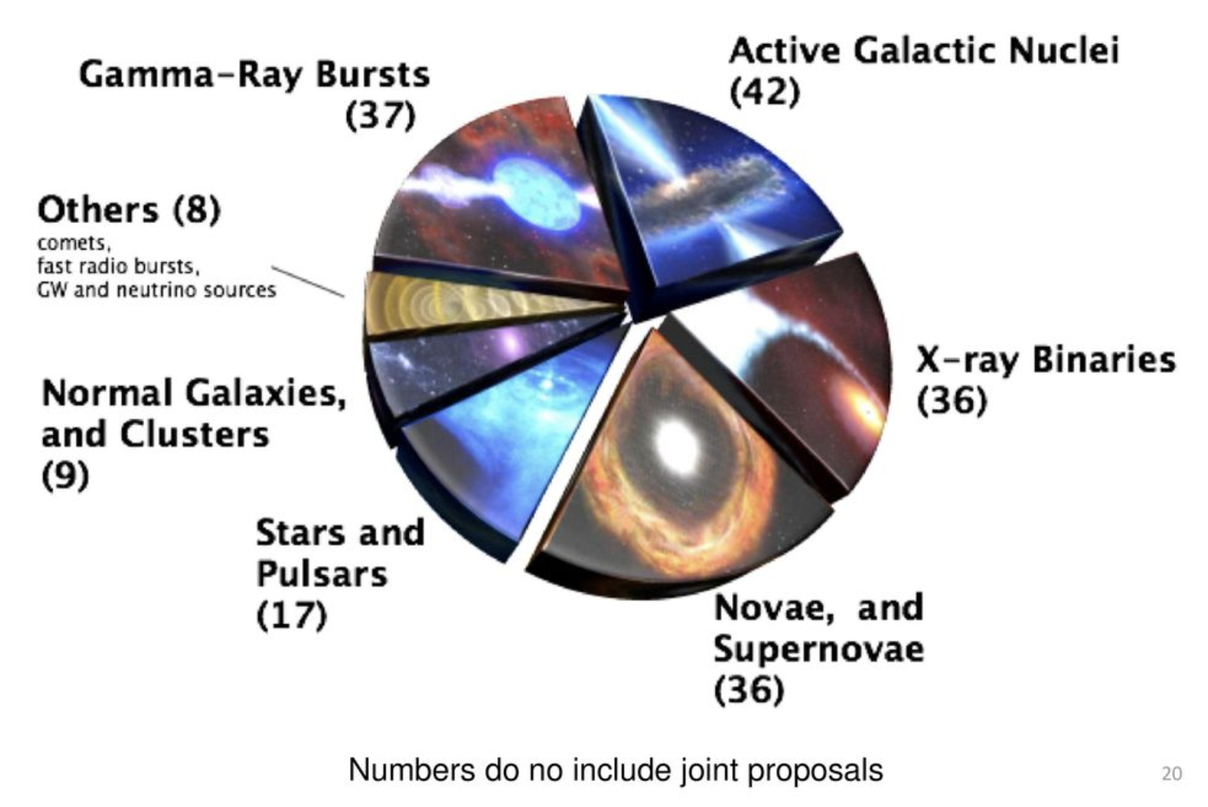
Beyond GRBs
Exploring the Universe with BAT
BAT science Coded mask BAT products Weak sources Summary
Credit: Topics of Swift GI proposals someone’s talk at Penn State

Slide 11
Beyond GRBs
Exploring the Universe with BAT
BAT science Coded mask BAT products Weak sources Summary
BAT triggers on sources beyond GRBs. E.g.,
  Soft Gamma-ray Repeaters (SGRs)
BAT light curve on the forests of bursts
from recent activities of SGR 1935+2154 related to fast radio bursts
Credit: David Palmer

Slide 12
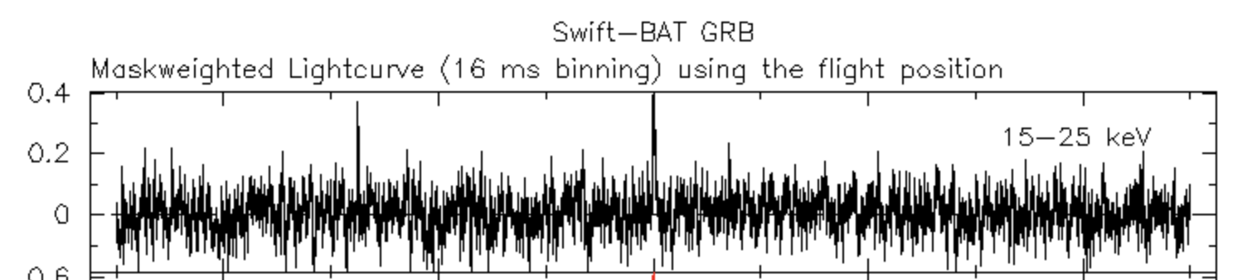
Beyond GRBs
Exploring the Universe with BAT
BAT science Coded mask BAT products Weak sources Summary
BAT triggers on sources beyond GRBs. E.g.,
  Soft Gamma-ray Repeaters (SGRs)
A new SGR just triggered by BAT last Saturday!

Slide 13
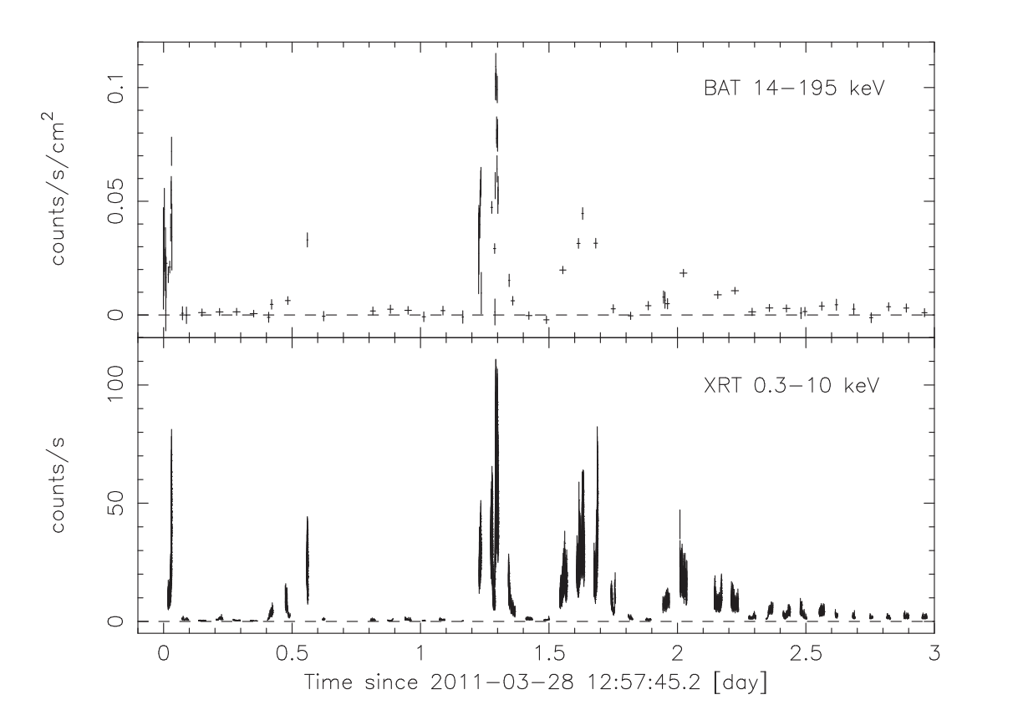
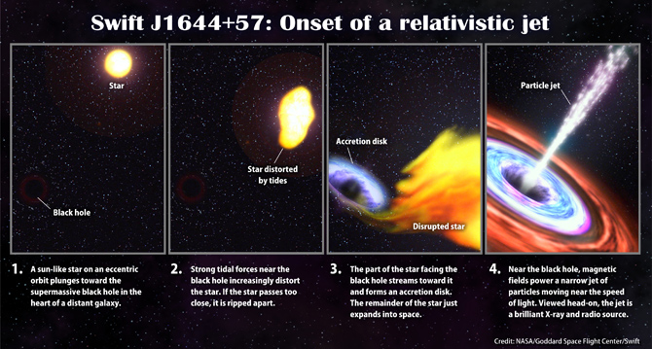
Beyond GRBs
Exploring the Universe with BAT
BAT science Coded mask BAT products Weak sources Summary
BAT triggers on sources beyond GRBs. E.g.,
  Soft Gamma-ray Repeaters (SGRs)
  Tidal disruption event
Burrows et al. (2011)
Credit: nasa.gov

Slide 14
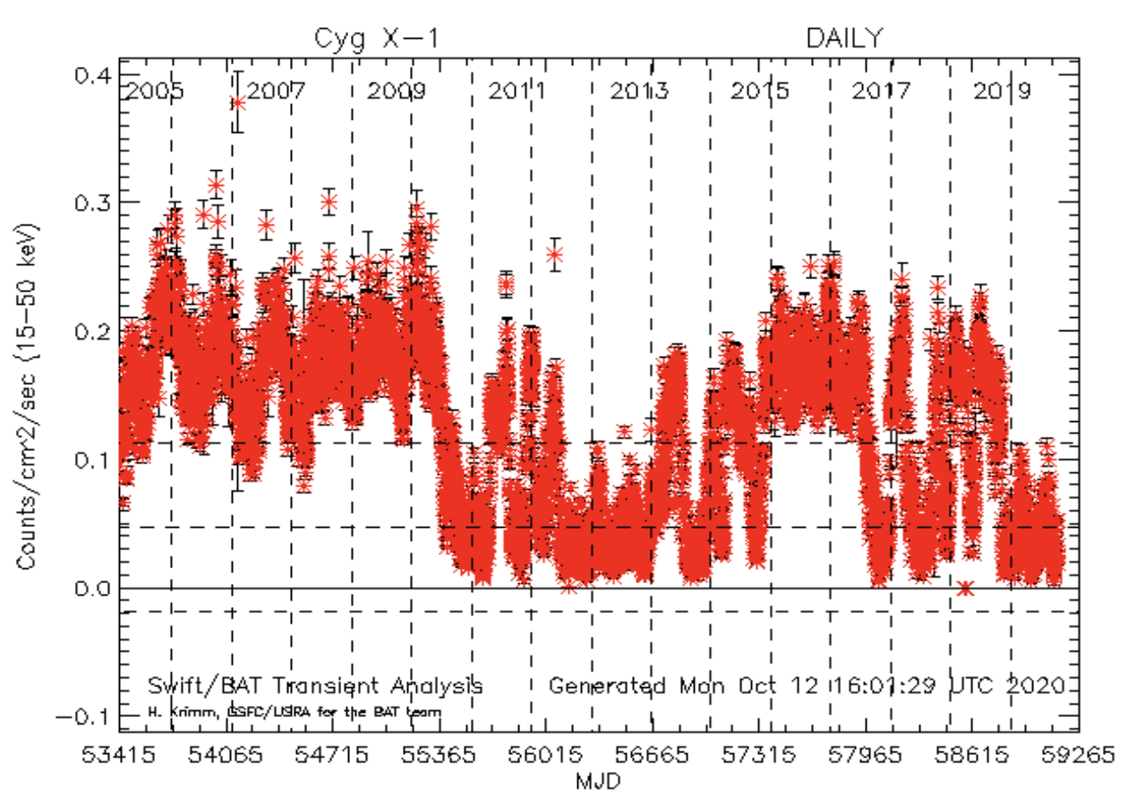
Beyond GRBs
Exploring the Universe with BAT
BAT science Coded mask BAT products Weak sources Summary
BAT triggers on sources beyond GRBs. E.g.,
  Soft Gamma-ray Repeaters (SGRs)
  Tidal disruption event
Long-term monitoring of hard X-ray sources
  Monitoring > 2000 known sources
  ~ 16 years and counting…
BAT transient monitor daily light curve
Krimm et al. (2013)

Slide 15
Beyond GRBs
Exploring the Universe with BAT
BAT science Coded mask BAT products Weak sources Summary
BAT triggers on sources beyond GRBs. E.g.,
  Soft Gamma-ray Repeaters (SGRs)
  Tidal disruption event
Long-term monitoring of hard X-ray sources
  Monitoring > 2000 known sources
  ~ 16 years and counting…
Deep hard X-ray survey on mosaic images throughout the entire mission time.

Slide 16
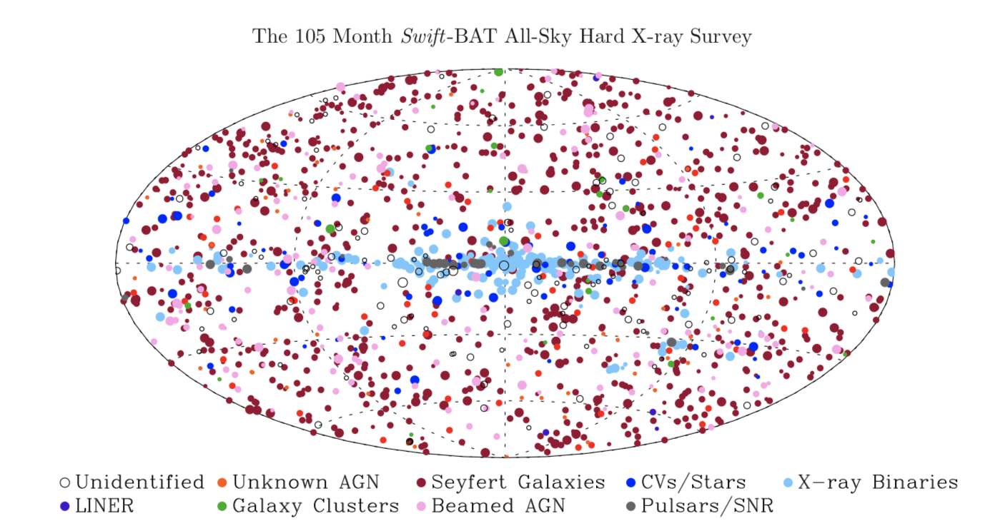
Beyond GRBs
Exploring the Universe with BAT
BAT science Coded mask BAT products Weak sources Summary
Oh et al. (2018)

Slide 17
Beyond GRBs
Exploring the Universe with BAT
BAT science Coded mask BAT products Weak sources Summary
BAT triggers on sources beyond GRBs. E.g.,
  Soft Gamma-ray Repeaters (SGRs)
  Tidal disruption event
Long-term monitoring of hard X-ray sources
  Monitoring > 2000 known sources
  ~ 16 years and counting…
Deep hard X-ray survey on mosaic images throughout the entire mission time.

Slide 18
BAT science Coded mask BAT products Weak sources Summary
Beyond GRBs
Exploring the Universe with BAT
BAT triggers on sources beyond GRBs. E.g.,
  Soft Gamma-ray Repeaters (SGRs)
  Tidal disruption event
Long-term monitoring of hard X-ray sources
  Monitoring > 2000 known sources
  ~ 16 years and counting…
Deep hard X-ray survey on mosaic images throughout the entire mission time.
Numerous counterpart searches

Slide 19
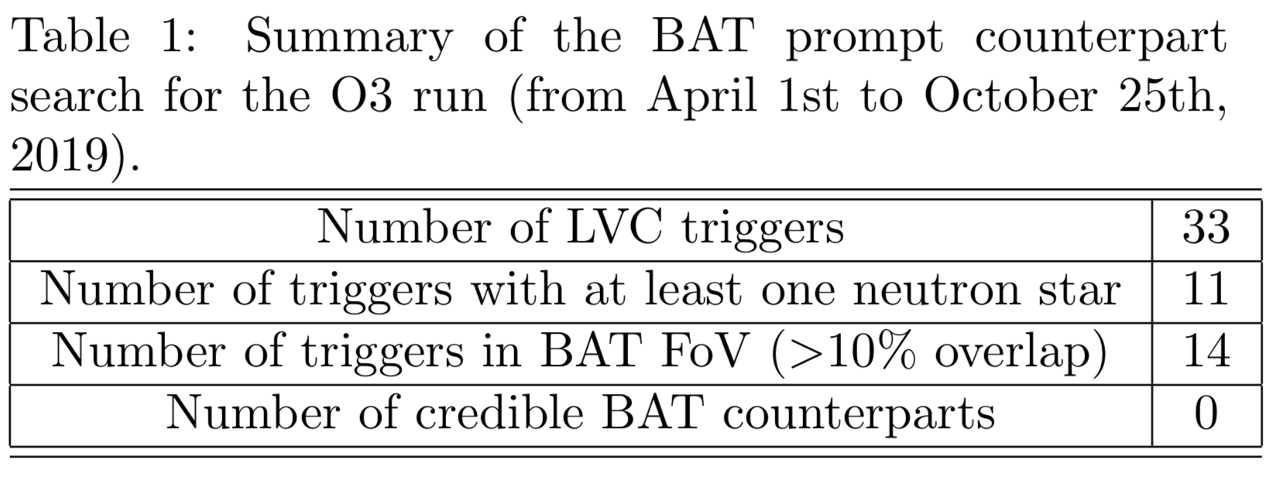
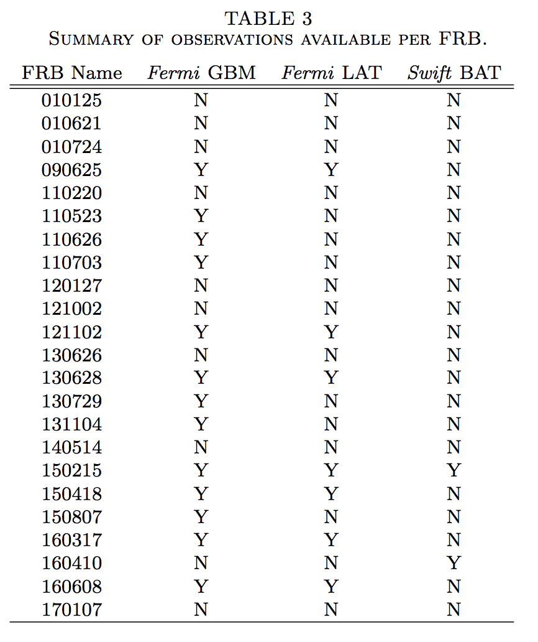
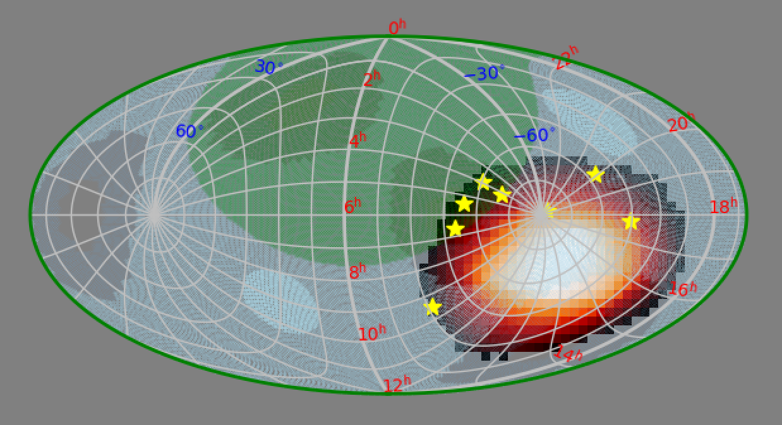
Beyond GRBs
Exploring the Universe with BAT
BAT science Coded mask BAT products Weak sources Summary
GW counterpart searches
FRB counterpart searches
Lien et al. 2019
Cunningham et al. 2019

Slide 20
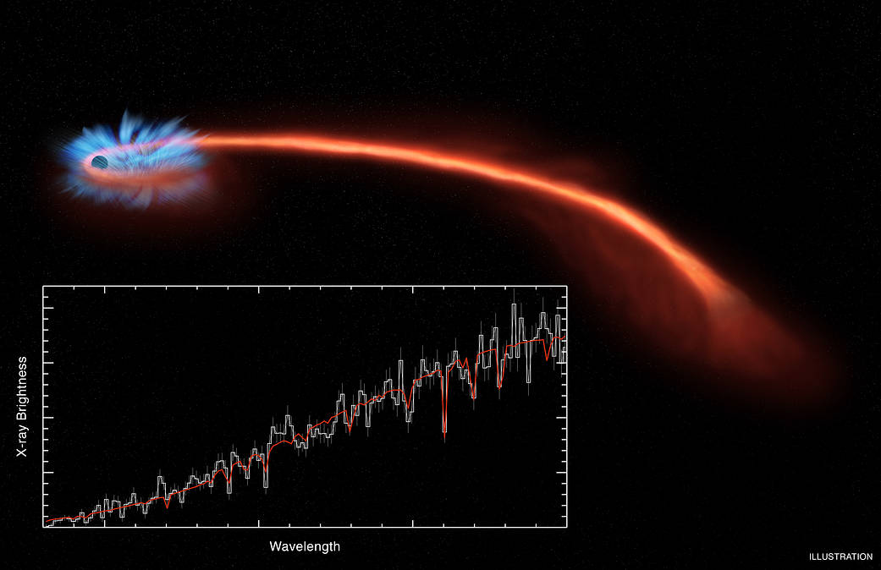
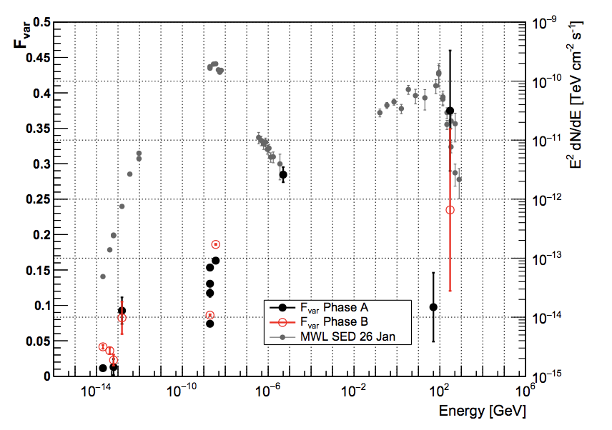
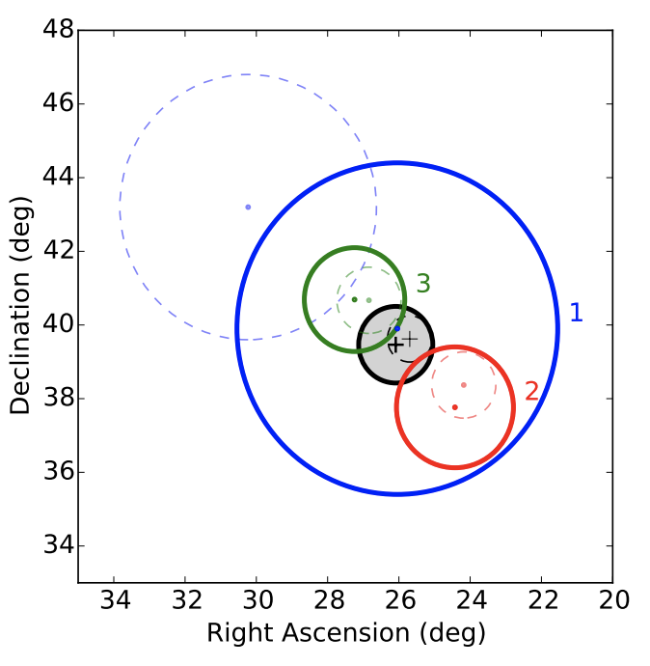
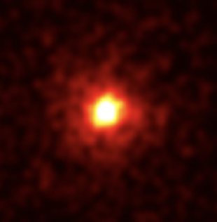
Beyond GRBs
Exploring the Universe with BAT
BAT science Coded mask BAT products Weak sources Summary
AT2018cow: A white dwarf tidal disruption event?
(Kuin et al. 2018)
Multi-wavelength characterization of the blazar S5 0716+714
during an unprecedented outburst phase
(MAGIC Collaboration, A&A, 2018)
Fig credit: Fermi/LAT
Oh et al. (2018)
Multiwavelength follow-up of a rare IceCube neutrino multiplet
(IceCube Collaboration, A&A, 2017)
The largest glitch observed in the Crab pulsar
(Shaw et al. MNRAS, 2018)

Slide 21
Beyond GRBs
Exploring the Universe with BAT
BAT science Coded mask BAT products Weak sources Summary
BAT triggers on sources beyond GRBs. E.g.,
  Soft Gamma-ray Repeaters (SGRs)
  Tidal disruption event
Long-term monitoring of hard X-ray sources
  Monitoring > 2000 known sources
  ~ 16 years and counting…
Deep hard X-ray survey on mosaic images throughout the entire mission time.
Numerous counterpart searches

Slide 22
Beyond GRBs
Exploring the Universe with BAT
BAT science Coded mask BAT products Weak sources Summary
BAT triggers on sources beyond GRBs:
  Soft Gamma-ray Repeaters (SGRs)
  Tidal disruption event
Long-term monitoring of hard X-ray sources
  Monitoring > 2000 known sources
  ~ 16 years and counting…
Deep hard X-ray survey on mosaic images throughout the entire mission time.
Numerous counterpart searches
Achievable thanks to
Large field of view
Decent localization
in hard X ray.

Slide 23
Beyond GRBs
Exploring the Universe with BAT
BAT science Coded mask BAT products Weak sources Summary
BAT triggers on sources beyond GRBs:
  Soft Gamma-ray Repeaters (SGRs)
  Tidal disruption event
Long-term monitoring of hard X-ray sources
  Monitoring > 2000 known sources
  ~ 16 years and counting…
Deep hard X-ray survey on mosaic images throughout the entire mission time.
Numerous counterpart searches
Achievable thanks to
Large field of view
Decent localization
in hard X ray.
Coded mask technique

Slide 24
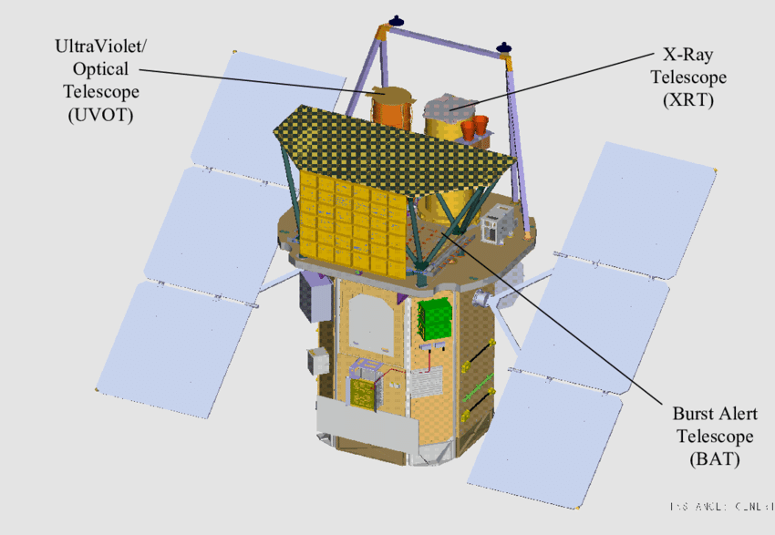
Coded-mask technique
BAT science Coded mask BAT products Weak sources Summary
Fig credit: Hullinger et al. 2006

Slide 25
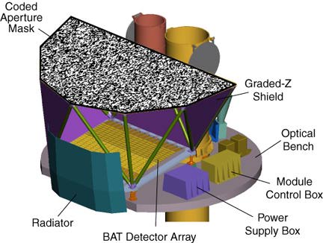
Coded-mask technique
BAT science Coded mask BAT products Weak sources Summary
Credit: NASA/Swift webpage
Fig credit: Hullinger et al. (2006)
Notes:
1 min
Tot: 7:30

Slide 26
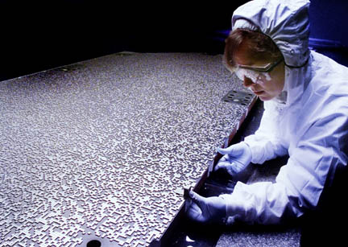
Coded-mask technique
BAT science Coded mask BAT products Weak sources Summary
Coded Aperture Mask
Credit: NASA/Swift webpage

Slide 27
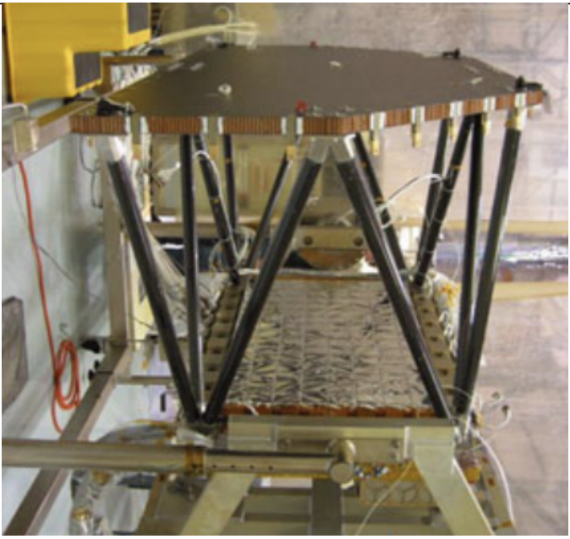
Coded-mask technique
BAT science Coded mask BAT products Weak sources Summary
Credit: NASA/Swift webpage
BAT detector array

Slide 28
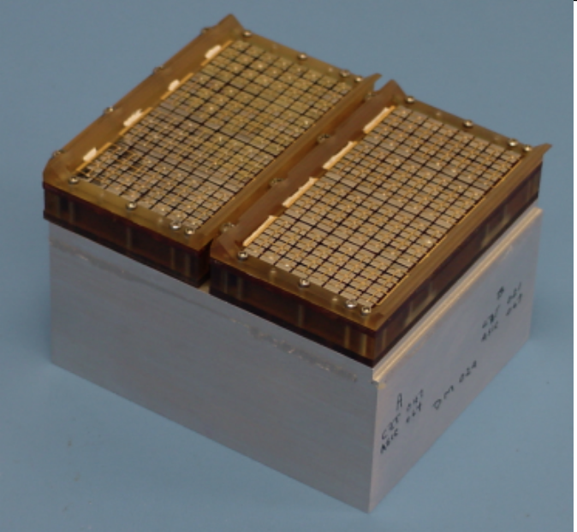
Coded-mask technique
BAT science Coded mask BAT products Weak sources Summary
A Detector Module (128*2 detectors)
BAT detectors:
32,768 CZT (CdZnTe) detectors
Energy range:
15-350 keV for detection
(15-200 keV for imaging)
Credit: NASA/Swift webpage

Slide 29
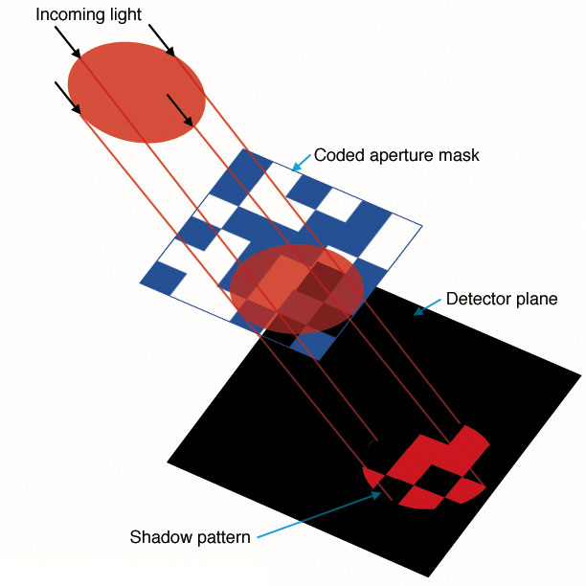
Coded-mask technique
BAT science Coded mask BAT products Weak sources Summary
Credit: NASA/Swift webpage

Slide 30
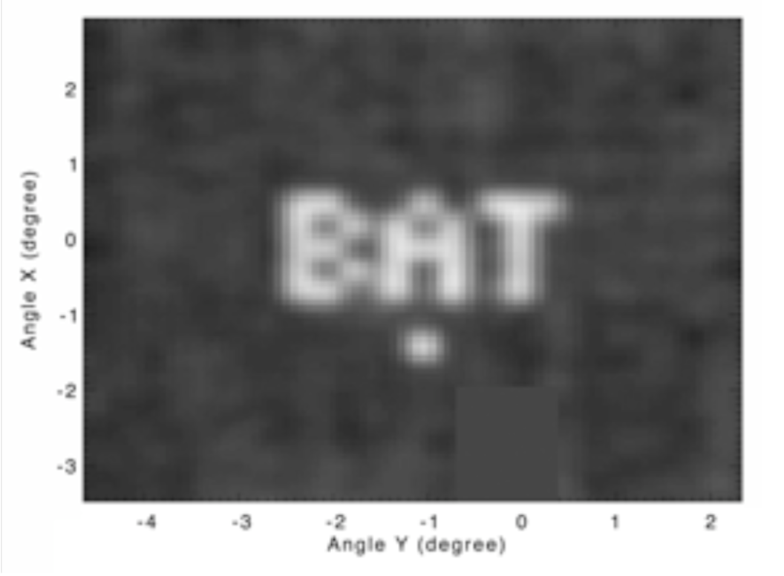
Coded-mask technique
BAT science Coded mask BAT products Weak sources Summary
Markwardt et al. (2007)
Barthelmy et al. (2005)

Slide 31
Mask-weighting analysis
BAT science Coded mask BAT products Weak sources Summary
Credit: NASA's Imagine the Universe and NASA/Swift

Slide 32
Mask-weighting analysis
BAT science Coded mask BAT products Weak sources Summary
Credit: NASA's Imagine the Universe and NASA/Swift

Slide 33
Mask-weighting analysis
BAT science Coded mask BAT products Weak sources Summary
Assigning weights
(w_{i})
0
0
0
0
0
0
0
0
0
0
1
0.8
1
0
0.5
1
0
0
0
0.6
0
0.9
0
0
0
0
0
0
Credit: NASA's Imagine the Universe and NASA/Swift
Notes:
maskwtcorrs.c
* maskwtnorm - compute mask weight normalization
*
* The mask weighting technique (i.e. mask-detector cross correlation)
* produces an image with units of "counts" but with a more or less
* arbitrary intensity scale. This routine computes the normalization
* based on the mask-detector geometry, and assuming the distribution
* of illumination fractions is known.
*
* double srcpos[3] - source position in BAT_X/Y/Z (cm)
* struct batmaskplane_struct *mask - mask orientation
* struct batdetplane_struct *detplane - detector plane orientation
*
* RETURNS: mask weight technique normalization.
* Users are meant to take (maskwtval)/(maskwtnorm) to arrive at
* the true sky counts, where maskwtval is the weighted sum
* measured from the detector data.

Slide 34
Mask-weighting analysis
BAT science Coded mask BAT products Weak sources Summary
Rebalancing
Sum(w_{i}) = 0
→ So background average to zero
0
0
0
0
0
0
0
0
0
0
1
0.8
1
0
0.5
1
0
0
0
0.6
0
0.9
0
0
0
0
0
0
Credit: NASA's Imagine the Universe and NASA/Swift
Notes:
maskwtcorrs.c
* maskwtnorm - compute mask weight normalization
*
* The mask weighting technique (i.e. mask-detector cross correlation)
* produces an image with units of "counts" but with a more or less
* arbitrary intensity scale. This routine computes the normalization
* based on the mask-detector geometry, and assuming the distribution
* of illumination fractions is known.
*
* double srcpos[3] - source position in BAT_X/Y/Z (cm)
* struct batmaskplane_struct *mask - mask orientation
* struct batdetplane_struct *detplane - detector plane orientation
*
* RETURNS: mask weight technique normalization.
* Users are meant to take (maskwtval)/(maskwtnorm) to arrive at
* the true sky counts, where maskwtval is the weighted sum
* measured from the detector data.

Slide 35
Mask-weighting analysis
BAT science Coded mask BAT products Weak sources Summary
Uniform bkg:
1 ct/pix
Weight (w_{i})
1
Imagine there is a uniform background
of 1 photon per detector
1
1
1
1
1
1
1
1
0
1
1
1
1
0
1
1
1
1
1
0
0
1
1
0
0
0
1
1
1
1
1
0
1
1
0
0
1
1
1
0.8
1
1
1
1
0
1
1
1
0.5
1
0
1
1
0
0
0.6
1
1
0.9
1
1
0
0
0
1
1
0
0
0
0
Credit: NASA's Imagine the Universe and NASA/Swift
Notes:
maskwtcorrs.c
* maskwtnorm - compute mask weight normalization
*
* The mask weighting technique (i.e. mask-detector cross correlation)
* produces an image with units of "counts" but with a more or less
* arbitrary intensity scale. This routine computes the normalization
* based on the mask-detector geometry, and assuming the distribution
* of illumination fractions is known.
*
* double srcpos[3] - source position in BAT_X/Y/Z (cm)
* struct batmaskplane_struct *mask - mask orientation
* struct batdetplane_struct *detplane - detector plane orientation
*
* RETURNS: mask weight technique normalization.
* Users are meant to take (maskwtval)/(maskwtnorm) to arrive at
* the true sky counts, where maskwtval is the weighted sum
* measured from the detector data.

Slide 36
Mask-weighting analysis
BAT science Coded mask BAT products Weak sources Summary
Uniform bkg:
1 ct/pix
Weight (w_{i})
1
Imagine there is a uniform background
of 1 photon per detector
Mask-weighted count for this source location:
Sum(bkg*w_{i}) = 1*0.8 + 1*1 + 1*1 + 1*1 + 1*0.6 + 1*0.5 + 1*0.9 = 5.8
1
1
1
1
1
1
1
1
0
1
1
1
1
0
1
1
1
1
1
0
0
1
1
0
0
0
1
1
1
1
1
0
1
1
0
0
1
1
1
0.8
1
1
1
1
0
1
1
1
0.5
1
0
1
1
0
0
0.6
1
1
0.9
1
1
0
0
0
1
1
0
0
0
0
Credit: NASA's Imagine the Universe and NASA/Swift
Notes:
maskwtcorrs.c
* maskwtnorm - compute mask weight normalization
*
* The mask weighting technique (i.e. mask-detector cross correlation)
* produces an image with units of "counts" but with a more or less
* arbitrary intensity scale. This routine computes the normalization
* based on the mask-detector geometry, and assuming the distribution
* of illumination fractions is known.
*
* double srcpos[3] - source position in BAT_X/Y/Z (cm)
* struct batmaskplane_struct *mask - mask orientation
* struct batdetplane_struct *detplane - detector plane orientation
*
* RETURNS: mask weight technique normalization.
* Users are meant to take (maskwtval)/(maskwtnorm) to arrive at
* the true sky counts, where maskwtval is the weighted sum
* measured from the detector data.

Slide 37
Mask-weighting analysis
BAT science Coded mask BAT products Weak sources Summary
Uniform bkg:
1 ct/pix
Weight (w_{i})
1
Imagine there is a uniform background
of 1 photon per detector
Mask-weighted count for this source location:
Sum(bkg*w_{i}) = 1*0.8 + 1*1 + 1*1 + 1*1 + 1*0.6 + 1*0.5 + 1*0.9 = 5.8
1
1
1
1
1
1
1
1
0
1
1
1
1
0
1
1
1
1
1
0
0
1
1
0
0
0
1
1
1
1
1
0
1
1
0
0
But we know this is just background,
So we would like the resulting mask-weighting count to be zero
Rebalacing (for example, w_{i}-0.1)
Sum(bkg*(w_{i}-0.1)) = 1*0.7 + 1*0.9 + 1*0.9 + 1*0.9 + 1*0.5 + 1*0.4 + 1*0.8
– 0.1*(rest of the detector weights)
= 0
1
1
1
0.8
1
1
1
1
0
1
1
1
0.5
1
0
1
1
0
0
0.6
1
1
0.9
1
1
0
0
0
1
1
0
0
0
0
Credit: NASA's Imagine the Universe and NASA/Swift
Notes:
maskwtcorrs.c
* maskwtnorm - compute mask weight normalization
*
* The mask weighting technique (i.e. mask-detector cross correlation)
* produces an image with units of "counts" but with a more or less
* arbitrary intensity scale. This routine computes the normalization
* based on the mask-detector geometry, and assuming the distribution
* of illumination fractions is known.
*
* double srcpos[3] - source position in BAT_X/Y/Z (cm)
* struct batmaskplane_struct *mask - mask orientation
* struct batdetplane_struct *detplane - detector plane orientation
*
* RETURNS: mask weight technique normalization.
* Users are meant to take (maskwtval)/(maskwtnorm) to arrive at
* the true sky counts, where maskwtval is the weighted sum
* measured from the detector data.

Slide 38
Mask-weighting analysis
BAT science Coded mask BAT products Weak sources Summary
Rebalancing
Sum(w_{i}) = 0
→ So background average to zero
0
0
0
0
0
0
0
0
0
0
1
0.8
1
0
0.5
1
0
0
-0.1
0
0.6
0
0.9
0
0
0
0
0
0
Credit: NASA's Imagine the Universe and NASA/Swift
Notes:
maskwtcorrs.c
* maskwtnorm - compute mask weight normalization
*
* The mask weighting technique (i.e. mask-detector cross correlation)
* produces an image with units of "counts" but with a more or less
* arbitrary intensity scale. This routine computes the normalization
* based on the mask-detector geometry, and assuming the distribution
* of illumination fractions is known.
*
* double srcpos[3] - source position in BAT_X/Y/Z (cm)
* struct batmaskplane_struct *mask - mask orientation
* struct batdetplane_struct *detplane - detector plane orientation
*
* RETURNS: mask weight technique normalization.
* Users are meant to take (maskwtval)/(maskwtnorm) to arrive at
* the true sky counts, where maskwtval is the weighted sum
* measured from the detector data.

Slide 39
Mask-weighting analysis
BAT science Coded mask BAT products Weak sources Summary
Rebalancing
Sum(w_{i}) = 0
→ So background average to zero
-0.1
-0.1
-0.1
-0.1
-0.1
-0.1
-0.1
-0.1
-0.1
-0.1
0.9
0.7
0.9
-0.1
0.4
0.9
-0.1
-0.1
-0.1
0.6
-0.1
0.8
-0.1
-0.1
-0.1
-0.1
-0.1
-0.1
Credit: NASA's Imagine the Universe and NASA/Swift
Notes:
maskwtcorrs.c
* maskwtnorm - compute mask weight normalization
*
* The mask weighting technique (i.e. mask-detector cross correlation)
* produces an image with units of "counts" but with a more or less
* arbitrary intensity scale. This routine computes the normalization
* based on the mask-detector geometry, and assuming the distribution
* of illumination fractions is known.
*
* double srcpos[3] - source position in BAT_X/Y/Z (cm)
* struct batmaskplane_struct *mask - mask orientation
* struct batdetplane_struct *detplane - detector plane orientation
*
* RETURNS: mask weight technique normalization.
* Users are meant to take (maskwtval)/(maskwtnorm) to arrive at
* the true sky counts, where maskwtval is the weighted sum
* measured from the detector data.

Slide 40
Mask-weighting analysis
BAT science Coded mask BAT products Weak sources Summary
Mask-weighted count can be negative, but will average to zero during background period.
-0.1
-0.1
-0.1
-0.1
-0.1
-0.1
-0.1
-0.1
-0.1
-0.1
0.9
0.7
0.9
-0.1
0.4
0.9
-0.1
-0.1
-0.1
0.6
-0.1
0.8
-0.1
-0.1
-0.1
-0.1
-0.1
-0.1
Credit: NASA's Imagine the Universe and NASA/Swift
Notes:
maskwtcorrs.c
* maskwtnorm - compute mask weight normalization
*
* The mask weighting technique (i.e. mask-detector cross correlation)
* produces an image with units of "counts" but with a more or less
* arbitrary intensity scale. This routine computes the normalization
* based on the mask-detector geometry, and assuming the distribution
* of illumination fractions is known.
*
* double srcpos[3] - source position in BAT_X/Y/Z (cm)
* struct batmaskplane_struct *mask - mask orientation
* struct batdetplane_struct *detplane - detector plane orientation
*
* RETURNS: mask weight technique normalization.
* Users are meant to take (maskwtval)/(maskwtnorm) to arrive at
* the true sky counts, where maskwtval is the weighted sum
* measured from the detector data.

Slide 41
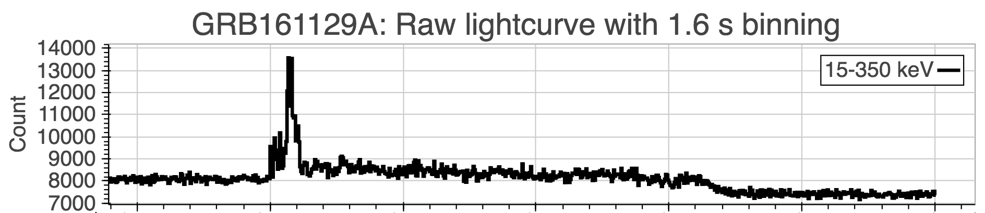
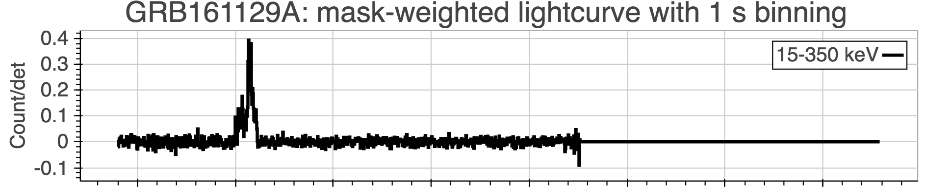
Mask-weighted light curve
BAT science Coded mask BAT products Weak sources Summary

Slide 42
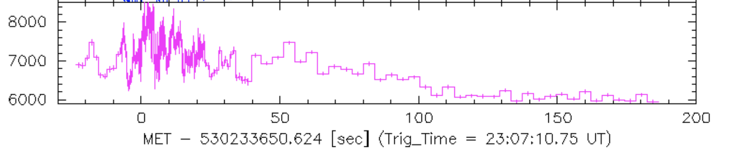
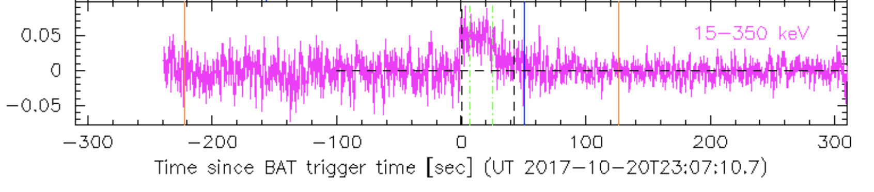
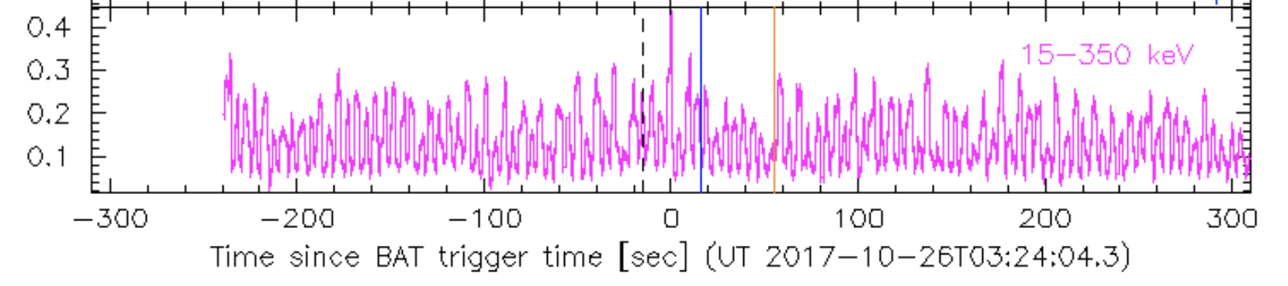
Mask-weighted light curve
BAT science Coded mask BAT products Weak sources Summary

Slide 43
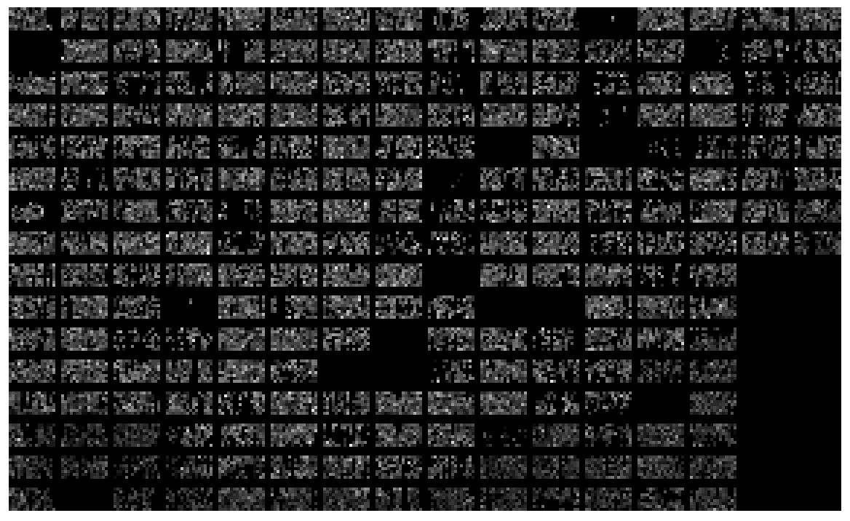

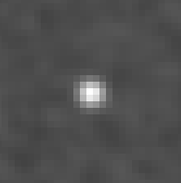
BAT science Coded mask BAT products Weak sources Summary
Image reconstruction
Detector Plane Image
Reconstructed Sky Image
～ 90 degree
～ 120 degree
GRB

Slide 44
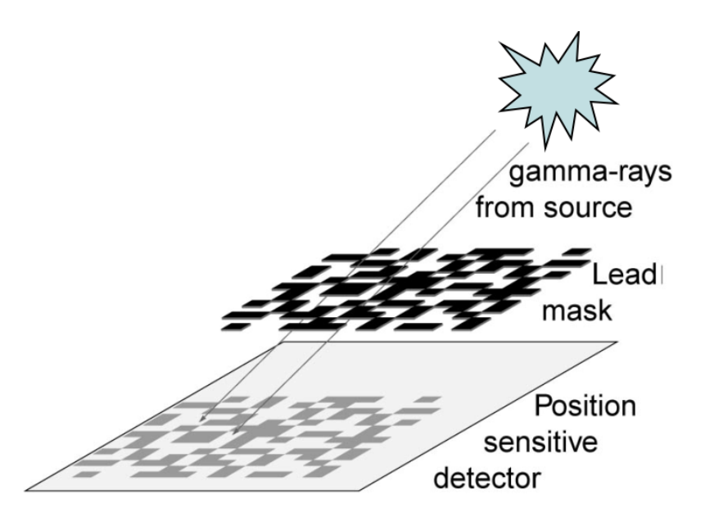
Partial coding fraction
BAT science Coded mask BAT products Weak sources Summary
Fraction of illuminated area
Source comes in from the zenith (0 deg boresight angle): pcode = 1
Source out of the field of view: pcode = 0
Larger pcode means more detectors are illuminated by the source, and thus BAT is more sensitive to the source.

Slide 45
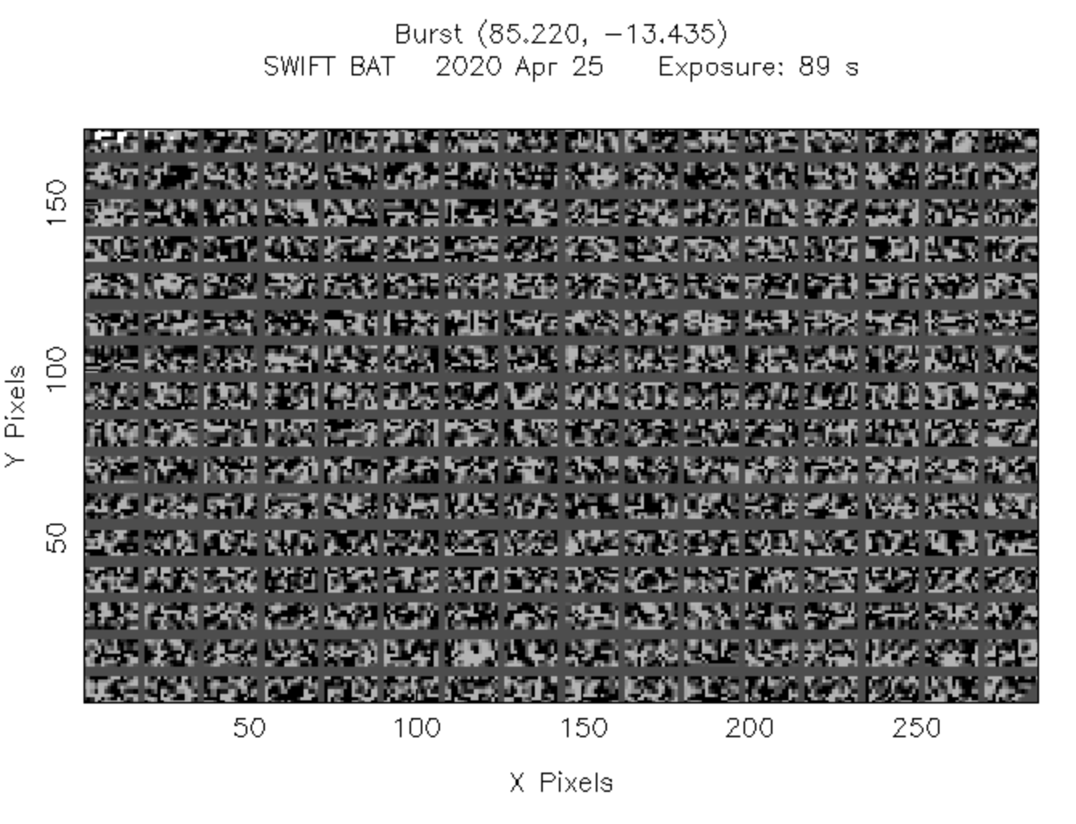
Partial coding fraction
BAT science Coded mask BAT products Weak sources Summary
pcode = 1
theta = 0 deg

Slide 46
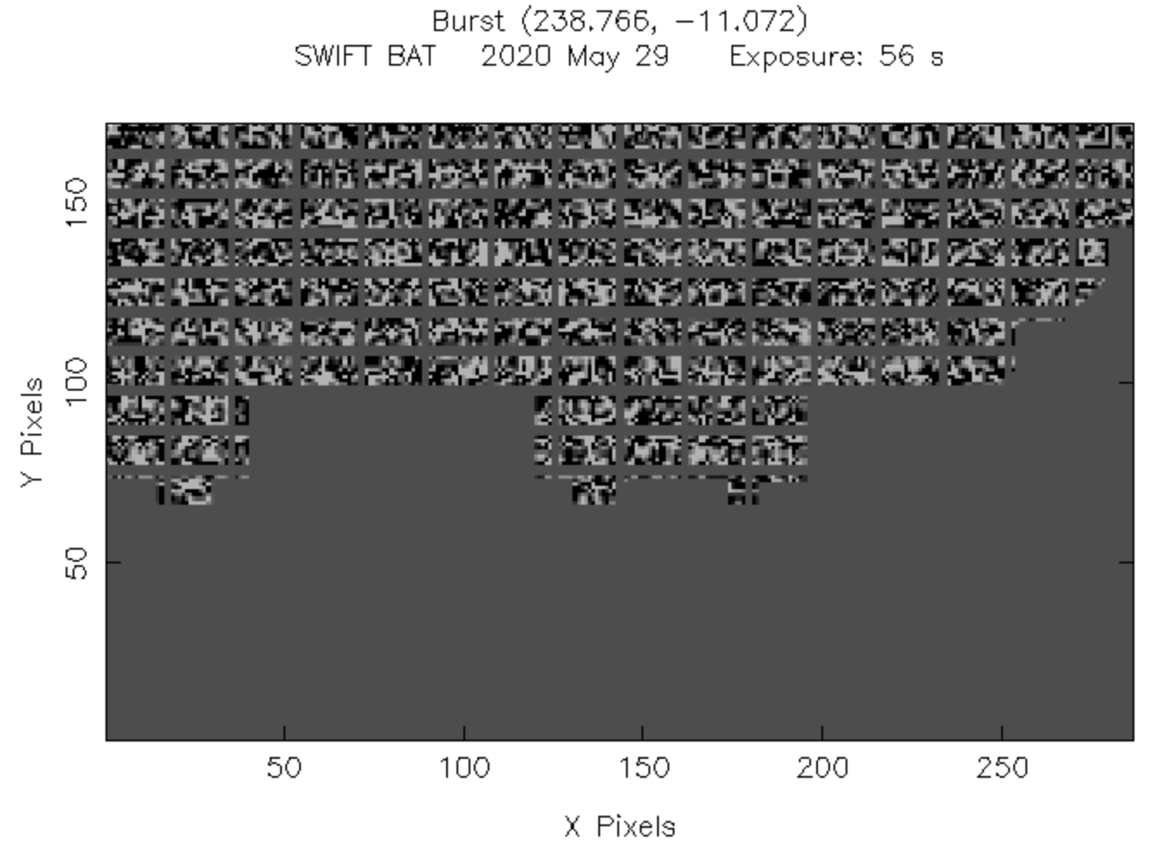
Partial coding fraction
BAT science Coded mask BAT products Weak sources Summary
29º
pcode = 0.5
theta = 29 deg

Slide 47
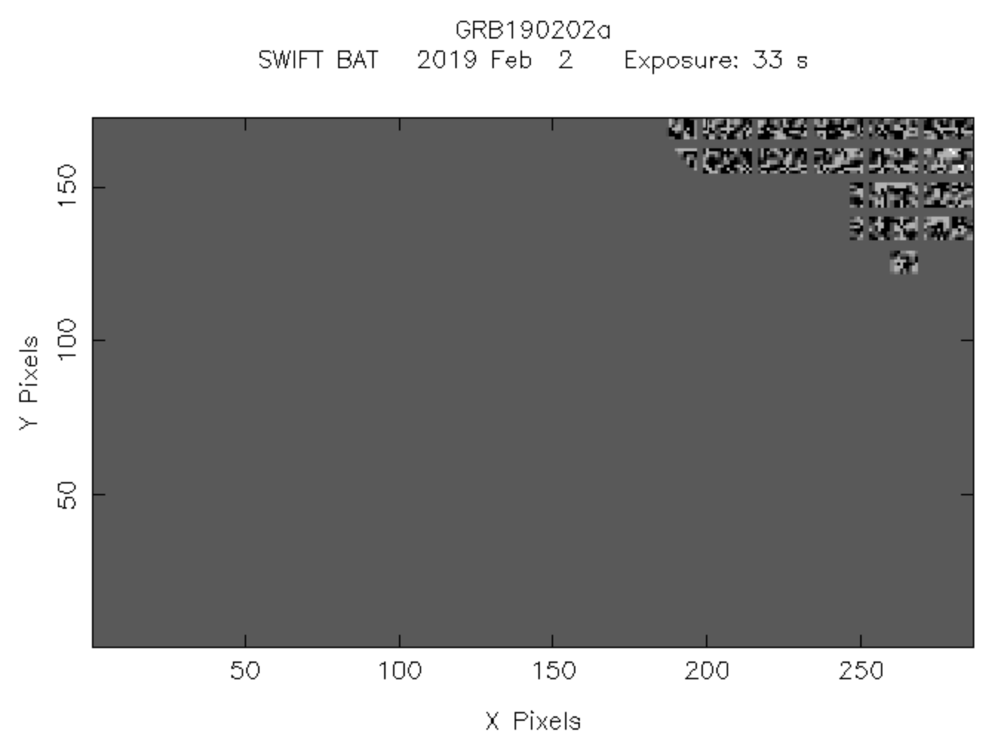
Partial coding fraction
BAT science Coded mask BAT products Weak sources Summary
50º
pcode = 0.04
theta = 50 deg

Slide 48
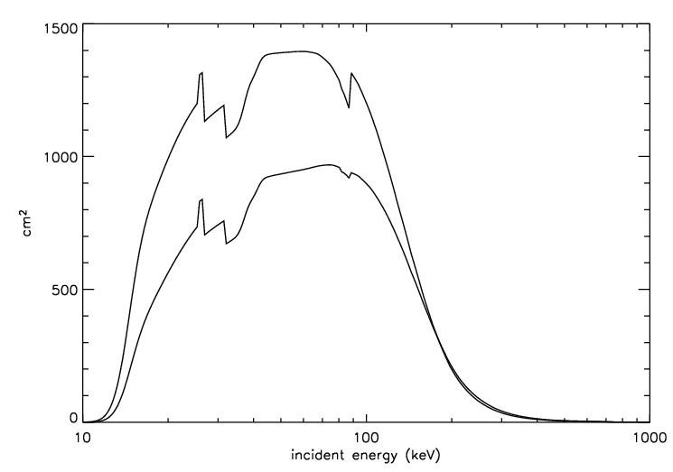
Partial coding fraction vs
BAT effective area
BAT science Coded mask BAT products Weak sources Summary
Ref: https://swift.gsfc.nasa.gov/analysis/bat_digest.html

Slide 49
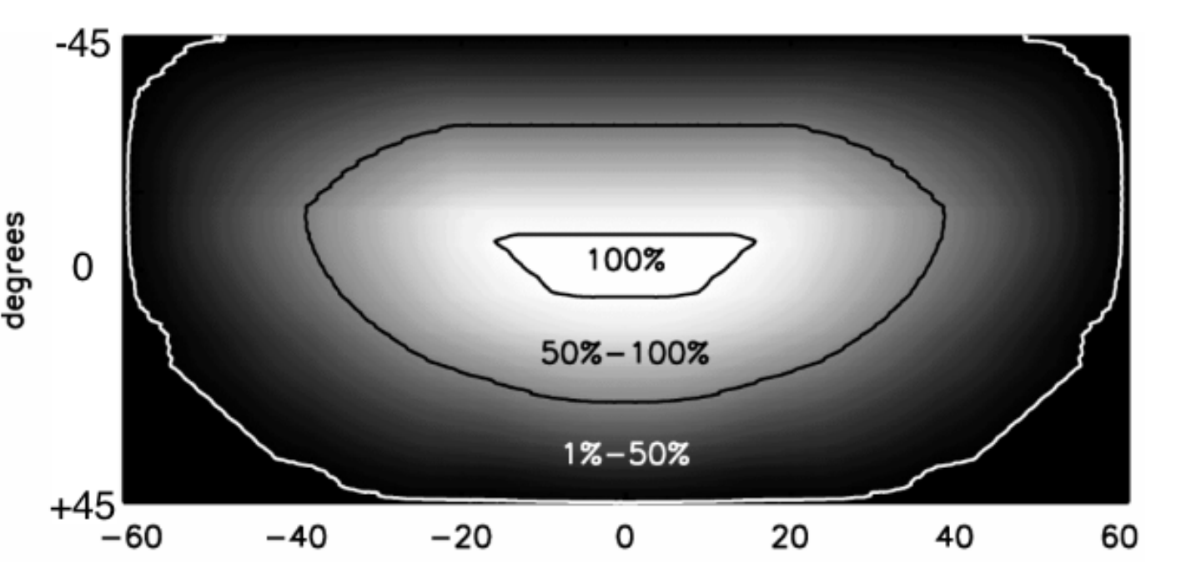
Partial coding fraction vs
BAT field of view
BAT science Coded mask BAT products Weak sources Summary

Slide 50
Mask-weighted count
BAT science Coded mask BAT products Weak sources Summary

Slide 51
Mask-weighted count
BAT science Coded mask BAT products Weak sources Summary
Definition:
Background subtracted counts
per fully illuminated detector
for an equivalent on-axis source
Ref: https://swift.gsfc.nasa.gov/analysis/threads/batfluxunitsthread.html

Slide 52
Mask-weighted count
BAT science Coded mask BAT products Weak sources Summary
Definition:
Background subtracted counts
per fully illuminated detector
for an equivalent on-axis source
Illuminated detector ～ # of enabled detector x pcode
Ref: https://swift.gsfc.nasa.gov/analysis/threads/batfluxunitsthread.html

Slide 53
Mask-weighted count
BAT science Coded mask BAT products Weak sources Summary
Definition:
Background subtracted counts
per fully illuminated detector
for an equivalent on-axis source
cos(θ) effect
Ref: https://swift.gsfc.nasa.gov/analysis/threads/batfluxunitsthread.html

Slide 54
Summery of coded mask instrument
BAT science Coded mask BAT products Weak sources Summary
Pros:
  Large field of view
  Decent localization for hard X ray
  Decent background estimation
Cons:
  Reduced sensitivity for the same number of detectors
  (mask covers > half of the detectors)
  Challenging to deal with diffuse sources
  All sources in the field of view will contribute to the noise
Sensitivity depends on the partial coding fraction

Slide 55
Exploring the Universe with BAT
BAT science Coded mask BAT products Weak sources Summary

Slide 56
BAT data type
BAT science Coded mask BAT products Weak sources Summary
DATA type | Description | Energy range | Can generate Image? | Time bin | Continuous?
Event data | Complete info of each photon | All | ✔ | Customizable (> 100 us) | ✗
Survey data | Pre-binned detector plane image | 80 channels (14-195 keV) | ✔ | ~ 300 s | ✔ (except during SAA and slew)
Scaled map data | Detector plane scaled map for image triggers | 15-50 keV | ✔ | ~ 8 s | ✔ (except during SAA and slew)
Rate data | Raw (not background subtracted) light curves | 4 channels (15-25, 25-50, 50-100,100-350 keV) | ✗ | 64 ms, 1 s, 1.6 s | ✔
For more info, see Markwardt et al. (2007)

Slide 57
BAT public products
BAT science Coded mask BAT products Weak sources Summary
BAT GRB catalog (event data)
  https://swift.gsfc.nasa.gov/results/batgrbcat/
BAT transient monitor (scaled map data)
  https://swift.gsfc.nasa.gov/results/transients/
BAT survey catalog (survey data)
  https://swift.gsfc.nasa.gov/results/bs105mon/

Slide 58
BAT transient monitor
BAT science Coded mask BAT products Weak sources Summary
Krimm et al. (2013)
Product made from scaled map data
https://swift.gsfc.nasa.gov/results/transients/
Energy range: 15-50 keV
Monitoring > 1000 sources
  daily light curves
  orbital light curves (time bins of ~ 64 second up to a couple thousand second).
Updated every few hours
If you’d like to add your favorite source to the monitoring list, send me an email!

Slide 59
BAT survey catalogs
BAT science Coded mask BAT products Weak sources Summary
Product made from BAT survey data
  Source detections on mosaic images
Existing BAT survey catalog
  3-month (Markwardt et al. 2005)
  22-month (Tueller et al. 2008)
  70-month (Baumgartner et al. 2013)
  105-month (Oh et al. 2018)
  Upcoming: 157-month (Lien et al. 2021 in prep)
  Other BAT survey catalogs:
  (using different analysis process)
    The Palermo Swift-BAT Hard X-ray Catalogs
      39-month, 54-month, (Cusumano et al. 2010)
    60-month (Ajello et al., 2012)
    3-year (Burlon & Ajello et al. 2011)

Slide 60
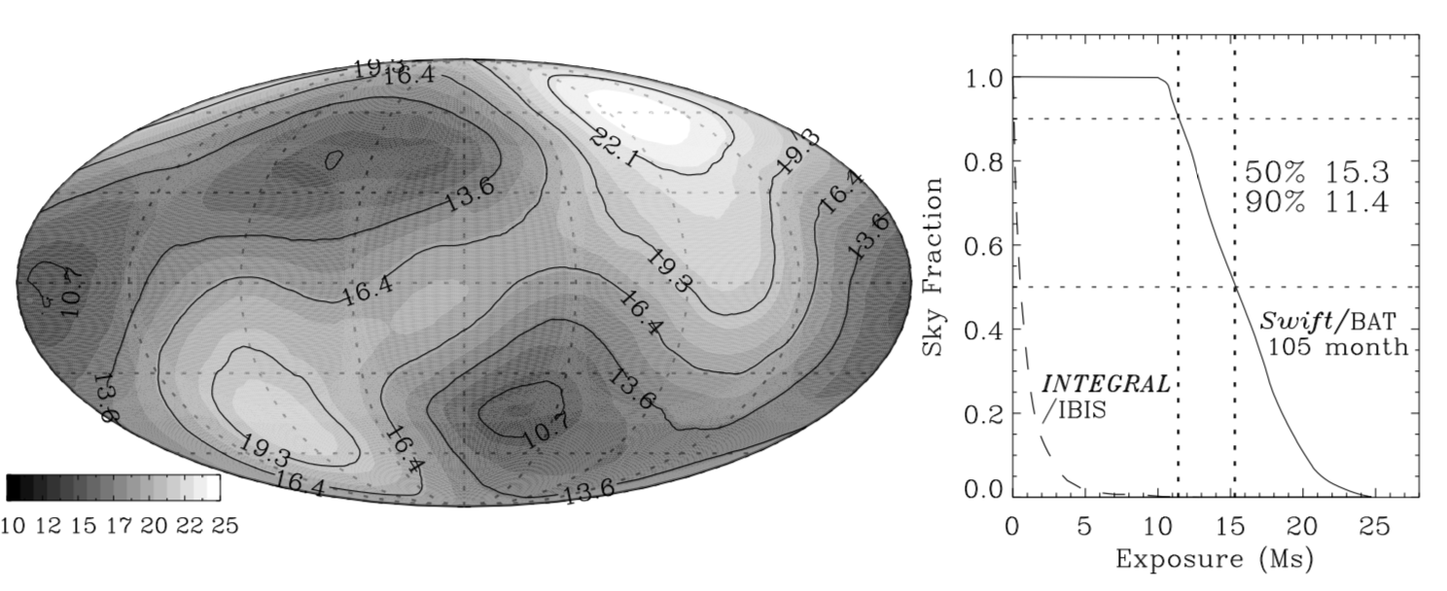
BAT survey exposure time
BAT science Coded mask BAT products Weak sources Summary
Oh et al. (2018)

Slide 61
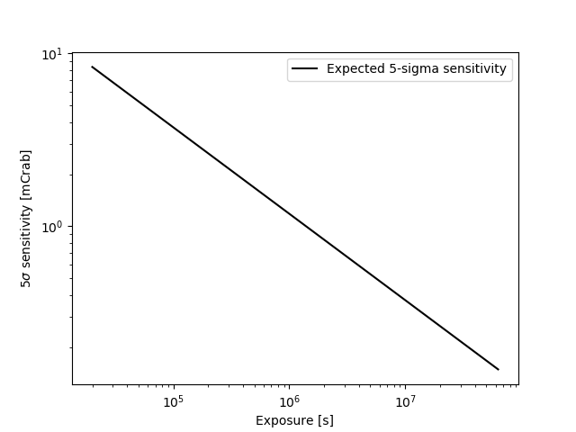
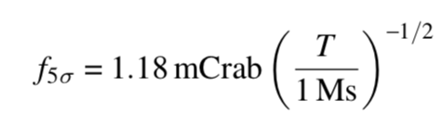
BAT sensitivity
BAT science Coded mask BAT products Weak sources Summary
1 mCrab = 2.42 x 10⁻¹¹ erg/s/cm²
2.42 x 10⁻¹⁰
9.86 x 10⁻¹¹
Eq. 9, Baumgardner et al. (2013)
2.42 x 10⁻¹¹
9.86 x 10⁻¹²
2.42 x 10⁻¹²

Slide 62
BAT sensitivity
BAT science Coded mask BAT products Weak sources Summary
GRB detections
1 mCrab = 2.42 x 10⁻¹¹ erg/s/cm²
2.42 x 10⁻¹⁰
9.86 x 10⁻¹¹
Lien et al. (2016)
Eq. 9, Baumgartner et al. (2013)
2.42 x 10⁻¹¹
9.86 x 10⁻¹²
2.42 x 10⁻¹²

Slide 63
BAT sensitivity
BAT science Coded mask BAT products Weak sources Summary
1 mCrab = 2.42 x 10⁻¹¹ erg/s/cm²
2.42 x 10⁻¹⁰
9.86 x 10⁻¹¹
Eq. 9, Baumgardner et al. (2013)
2.42 x 10⁻¹¹
9.86 x 10⁻¹²
2.42 x 10⁻¹²

Slide 64
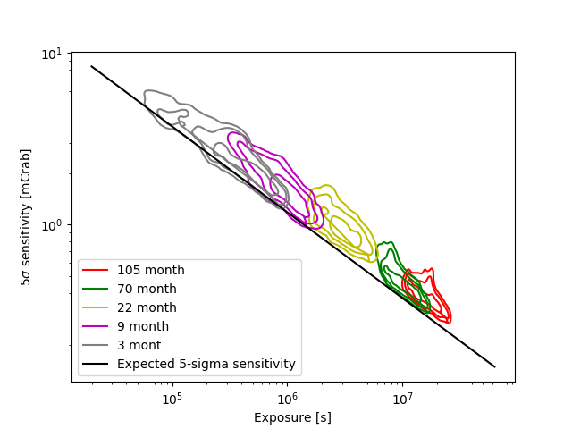
BAT survey catalogs
BAT science Coded mask BAT products Weak sources Summary
1 mCrab = 2.42 x 10⁻¹¹ erg/s/cm²
2.42 x 10⁻¹⁰
9.86 x 10⁻¹¹
2.42 x 10⁻¹¹
9.86 x 10⁻¹²
2.42 x 10⁻¹²
Markwardt et al. (2005); Tueller et al. (2008); Tueller et al. (2010); Baumgartner et al. (2013); Oh et al. (2018)

Slide 65
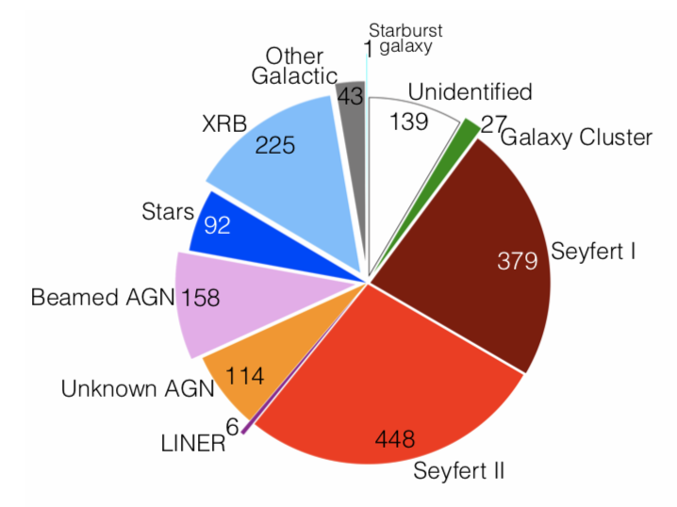
BAT survey catalogs
BAT science Coded mask BAT products Weak sources Summary
105 month
Oh et al. (2018)
Product at: https://swift.gsfc.nasa.gov/results/bs105mon/
- From Dec. 2004 to Aug. 2013.
- Monthly light curves, spectra…etc.

Slide 66
BAT survey catalogs
BAT science Coded mask BAT products Weak sources Summary
1 mCrab = 2.42 x 10⁻¹¹ erg/s/cm²
2.42 x 10⁻¹⁰
Coming up:
157 month catalog (end at Dec. 2017)
https://swift.gsfc.nasa.gov/results/bs157mon/
Monthly update of survey products
9.86 x 10⁻¹¹
2.42 x 10⁻¹¹
9.86 x 10⁻¹²
2.42 x 10⁻¹²
Markwardt et al. (2005); Tueller et al. (2008); Tueller et al. (2010); Baumgartner et al. (2013); Oh et al. (2018)

Slide 67
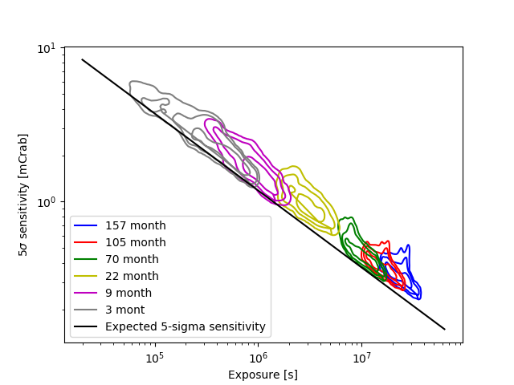
BAT survey catalogs
BAT science Coded mask BAT products Weak sources Summary
1 mCrab = 2.42 x 10⁻¹¹ erg/s/cm²
2.42 x 10⁻¹⁰
9.86 x 10⁻¹¹
2.42 x 10⁻¹¹
9.86 x 10⁻¹²
2.42 x 10⁻¹²
Markwardt et al. (2005); Tueller et al. (2008); Tueller et al. (2010); Baumgartner et al. (2013); Oh et al. (2018)

Slide 68
What if your favorite source is not in the public catalogs?
BAT science Coded mask BAT products Weak sources Summary
(Send me an email)
Do your own search
  All Swift data are available on HEASARC:
https://heasarc.gsfc.nasa.gov/cgi-bin/W3Browse/swift.pl

Slide 69
Will your sources be detected in BAT?
BAT science Coded mask BAT products Weak sources Summary
1 mCrab = 2.42 x 10⁻¹¹ erg/s/cm²
2.42 x 10⁻¹⁰
9.86 x 10⁻¹¹
Eq. 9, Baumgardner et al. (2013)
2.42 x 10⁻¹¹
9.86 x 10⁻¹²
2.42 x 10⁻¹²

Slide 70
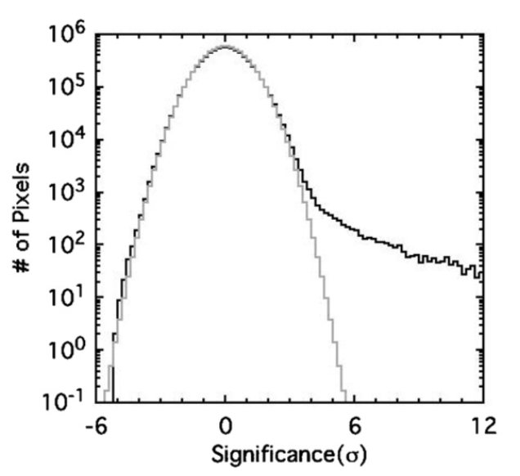
What is a real detection?
BAT science Coded mask BAT products Weak sources Summary
What counts as a detection in BAT?
  BAT onboard trigger algorithm: over 600 trigger criteria with different count rate threshold, ~ 7 sigma for image threshold.
  BAT survey catalog: 4.8 sigma.
    1.54 false detections
    in the mosaic sky map
    of 1.99 x 10⁶ pixels
    (Tueller et al. 2010).
Tueller et al. (2010)

Slide 71
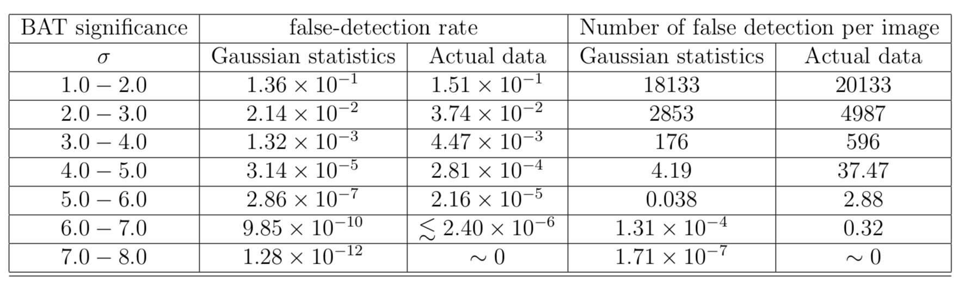
What is a real detection?
BAT science Coded mask BAT products Weak sources Summary

Slide 72
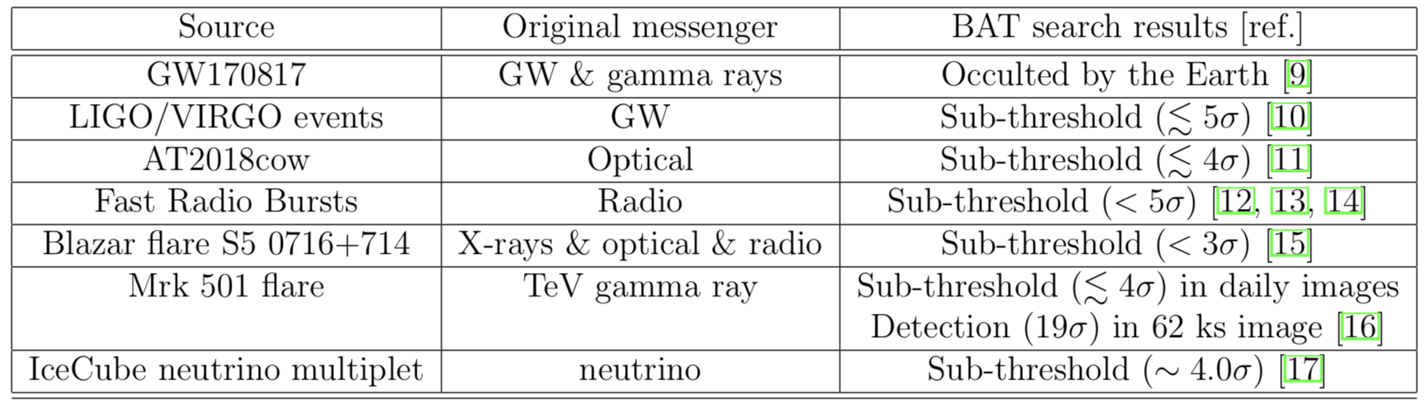
What is a real detection?
BAT science Coded mask BAT products Weak sources Summary
Sub-threshold events

Slide 73
Looking for dim signals in BAT:
Things to be aware of
BAT science Coded mask BAT products Weak sources Summary
Any sources in the FOV will affect the noise/flux estimation for your interested source.
BAT noise generally follows Gaussian statistics, however, we do see slight divergence from Gaussian, which might be especially important for sub-threshold signals.
More systematic noise at the edge of the field of view.
Be cautious of sources under ~ 7 sigma in an image.
There is additional systematic noise when integrating over ~ a few days (patter noise).
Detector noise that mimics a burst.

Slide 74
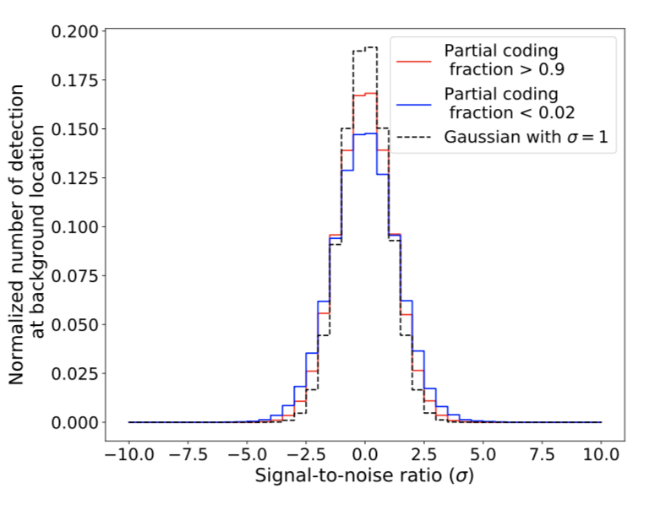
Looking for dim signals in BAT:
Things to be aware of
BAT science Coded mask BAT products Weak sources Summary
Any sources in the FOV will affect the noise/flux estimation for your interested source.
BAT noise generally follows Gaussian statistics, however, we do see slight divergence from Gaussian, which might be especially important for sub-threshold signals.
More systematic noise at the edge of the field of view.
Be cautious of sources under ~ 7 sigma in an image.
There is additional systematic noise when integrating over ~ a few days (patter noise).
Detector noise that mimics a burst.

Slide 75
Looking for dim signals in BAT:
Things to be aware of
BAT science Coded mask BAT products Weak sources Summary
Any sources in the FOV will affect the noise/flux estimation for your interested source.
BAT noise generally follows Gaussian statistics, however, we do see slight divergence from Gaussian, which might be especially important for sub-threshold signals.
More systematic noise at the edge of the field of view.
Be cautious of sources under ~ 7 sigma in an image..
There is additional systematic noise when integrating over ~ a few days (patter noise).
Detector noise that mimics a burst.

Slide 76
Looking for dim signals in BAT:
Things to be aware of
BAT science Coded mask BAT products Weak sources Summary
Any sources in the FOV will affect the noise/flux estimation for your interested source.
BAT noise generally follows Gaussian statistics, however, we do see slight divergence from Gaussian, which might be especially important for sub-threshold signals.
More systematic noise at the edge of the field of view.
Be cautious of sources under ~ 7 sigma in an image.
There is additional systematic noise when integrating over ~ a few days (patter noise).
Detector noise that mimics a burst.

Slide 77
Looking for dim signals in BAT:
Things to be aware of
BAT science Coded mask BAT products Weak sources Summary
Any sources in the FOV will affect the noise/flux estimation for your interested source.
BAT noise generally follows Gaussian statistics, however, we do see slight divergence from Gaussian, which might be especially important for sub-threshold signals.
More systematic noise at the edge of the field of view.
Be cautious of sources under ~ 7 sigma in an image.
There is additional systematic noise when integrating over ~ a few days (patter noise).
Detector noise that mimics a burst.

Slide 78
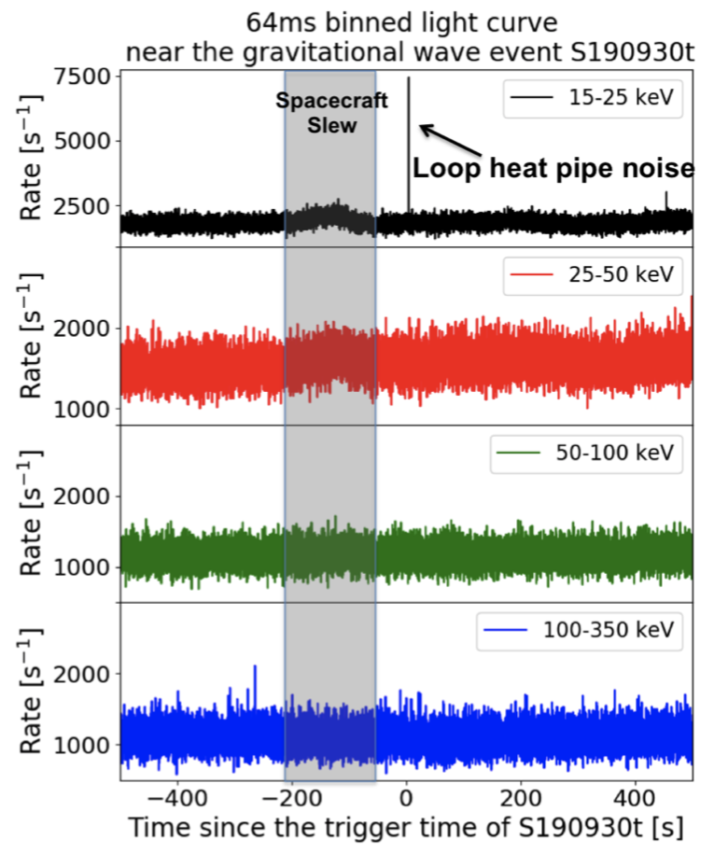
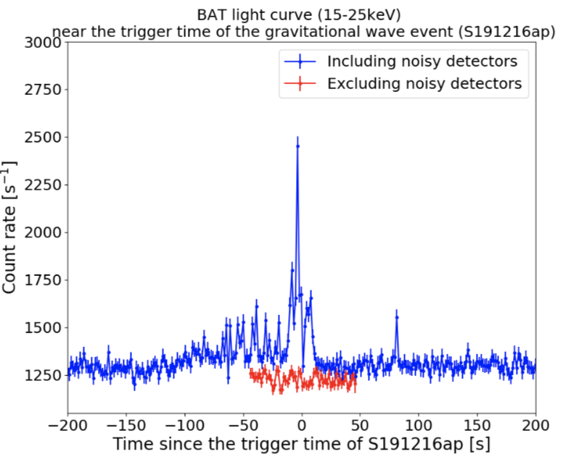
Looking for dim signals in BAT:
Things to be aware of
BAT science Coded mask BAT products Weak sources Summary
Any sources in the FOV will affect the noise/flux estimation for your interested source.
BAT noise generally follows Gaussian statistics, however, we do see slight divergence from Gaussian, which might be especially important for sub-threshold signals.
More systematic noise at the edge of the field of view.
Be cautious of sources under ~ 7 sigma in an image.
There is additional systematic noise when integrating over ~ a few days (patter noise).
Detector noise that mimics a burst.

Slide 79
Summary
BAT science Coded mask BAT products Weak sources Summary
BAT is useful for many astrophysical studies
  Large field of view (~ 1/6 of the sky)
  Decent source localization (~ 3 arcmin, depends on source brightness)
  16 years of data
Coded mask technique acts differently than focusing instruments
Be cautious about sub-threshold signals and detections with low partial coding fractions.
If you have any questions, please email me: amy.y.lien@nasa.gov

Slide 80
Backup

Slide 81
Discussion
BAT science Coded mask BAT products Weak sources Summary
Any particular ways or objects you would like to work with BAT data?
What other BAT product you would like?

Slide 82
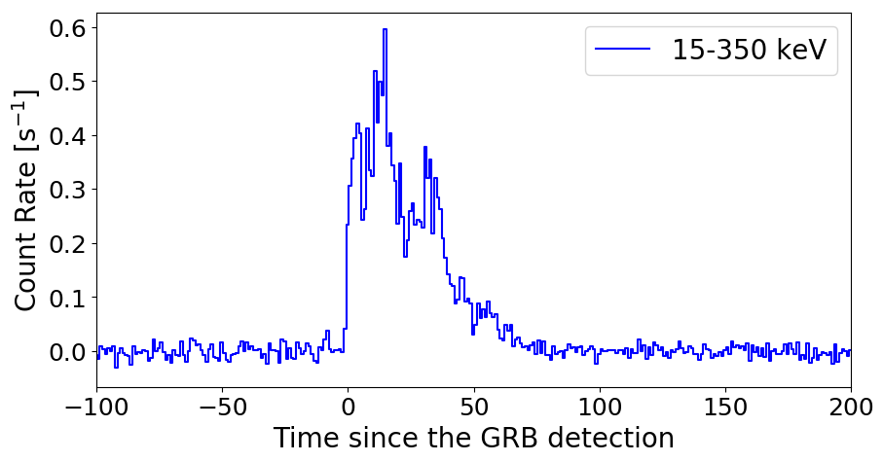
(b)
Detector Plane Image
(a) Coded-mask technique
Deconvolute from the mask pattern
(d)
Background-subtracted
(mask-weighted) light curve
(c)
Reconstructed Sky Image
～ 90 degree
GRB
～ 120 degree

Slide 84

BAT status update
- Annual Crab calibration

Slide 85

BAT status update
- Annual Crab calibration

Slide 86

BAT status update
- Annual Crab calibration

Slide 87

Mask-weighting analysis
Detector Plane Image (DPI)
Credit: NASA's Imagine the Universe and NASA/Swift

Slide 88
Mask-weighting analysis
Credit: NASA's Imagine the Universe and NASA/Swift

Slide 89
Science with BAT
GRBs, counterparts for gravitational waves, fast radio bursts, tidal disruption events, AGNs, x-ray binaries…etc.
Counterpart searches
Long-term monitoring of X-ray sources.
Deep hard X-ray image from 16 years of mission time.

Slide 90

BAT observation time

Slide 91

BAT detector

Slide 92
BAT sensitivity
Burst count \prop N \prop Ndet
Background count \prop N \prop Ndet
Noise \prop sqrt(N) \prop \sqrt(Ndet)
SNR \prop Ndet/sqrt(Ndet) \prop sqrt(Ndet)
Show more detail later in the survey catalog

Slide 93
BAT data type
BAT event data → BAT GRB catalog
  Not continuous
    Event data for BAT triggers – ~ 1000 s
    Event data for sub-threshold triggers (a.k.a. failed-event data) - ~ 3 to 10 s
    Slew event data – collected during spacecraft slews (currently turned off during the pandemic)
  You can request to get event data for your observed object
  GUANO system developed at the MOC can retrieve event data retroactively if notice is sent within a few minutes from T0.
BAT rate data
  Continuous
BAT survey data → BAT survey catalog
  Continuous during spacecraft pointing mode
BAT scaled map → BAT transient monitor
  Continuous during spacecraft pointing mode
Notes:
Make this into a table

